Slide 1


Slide 2
PROBLEM STATEMENT
This project deals with the data analysis of restaurant information in India. The project aims to explore hidden patterns that could affect the target variable - online order. The dataset is in CSV format and has been cleaned in the part 1 with proper data types and missing values. The project is divided into three steps.
The model that built in the above case study has gone to deployment and Zomato has been impressed with data analysis and has been believing that the analysis going to be impactful.
Now Zomato has been observing the orders happening online and offline, Due to offline orders, Zomato is not able to attract customers with diverse items and offers, and the user subscription also getting low. So, it has decided to give you the project on the same.
Now the problem statement is that Zomato wants to know whether the customer would order the orders online or offline so that Zomato can take further strategies to improve the online order.

Slide 3

OBJECTIVE
The Aim is to classify the orders that have been ordered online and offline and identify the patterns that lead to orders online orders as well as offline. The model should be able to classify the classes effectively.

Slide 4
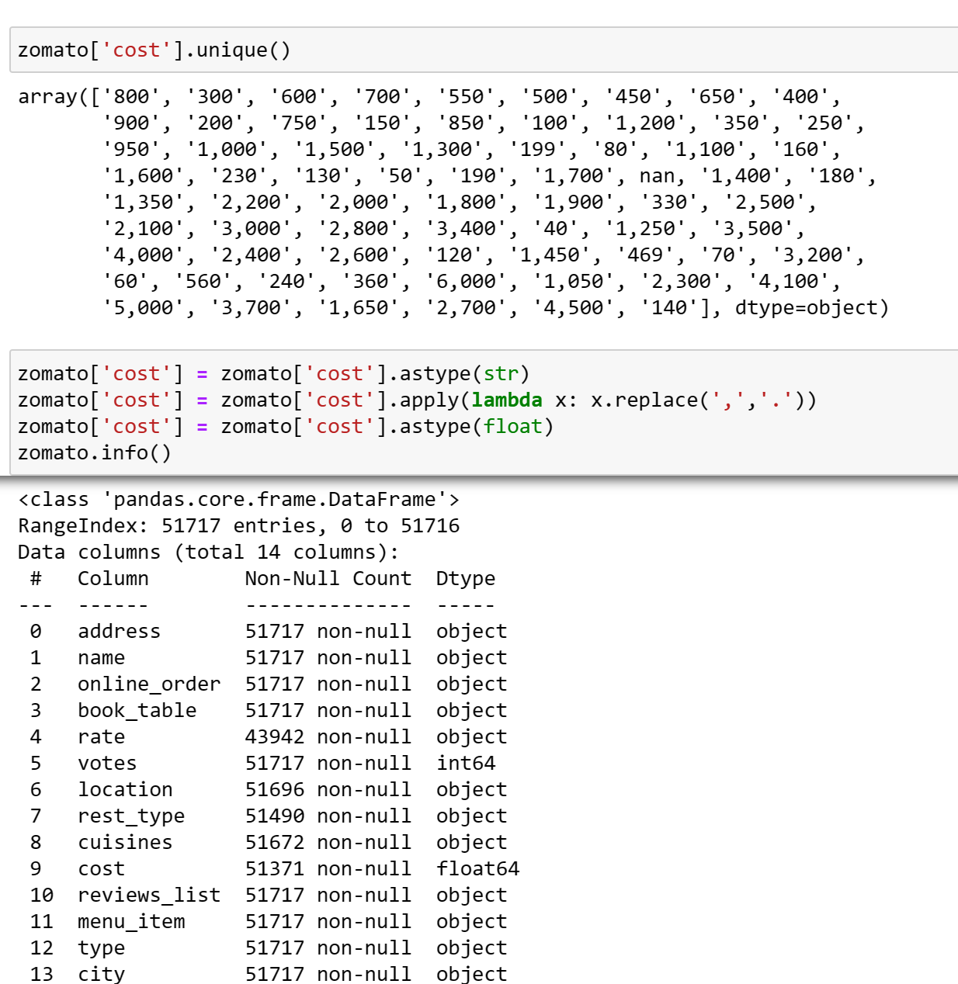
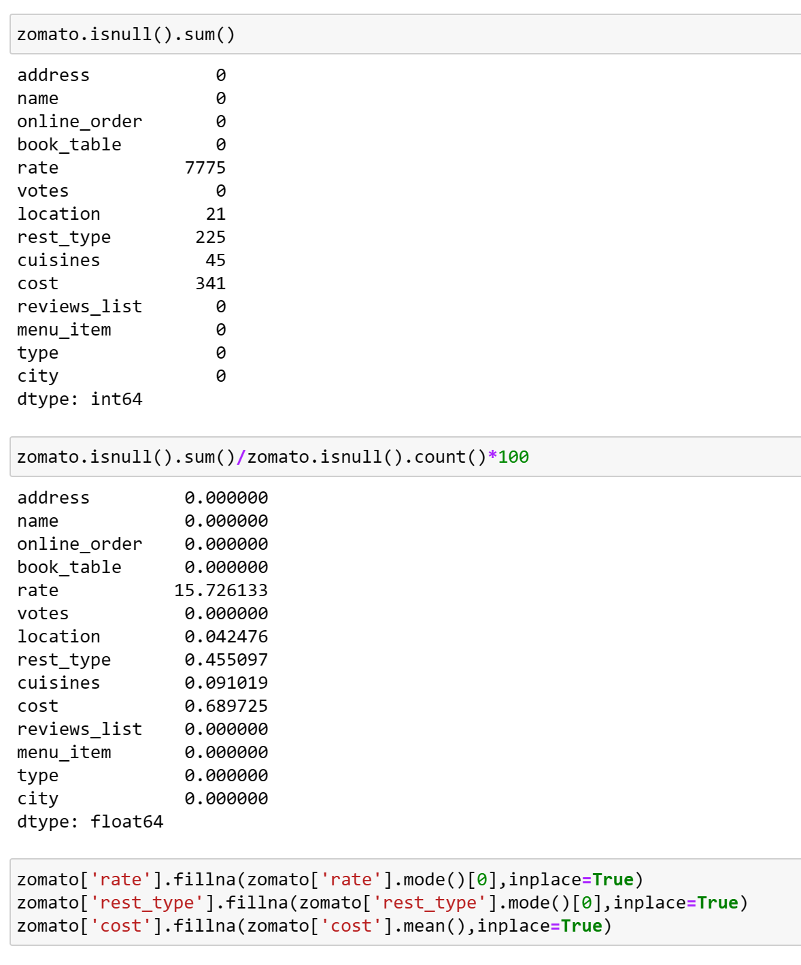
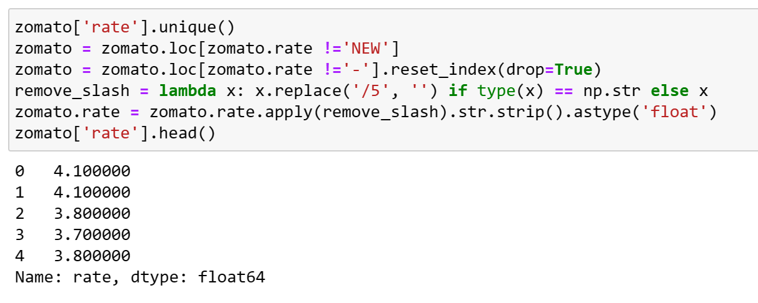
DATA CLEANING
Cleaning the data by replacing the null values with median values and drop the unwanted records.

Slide 5
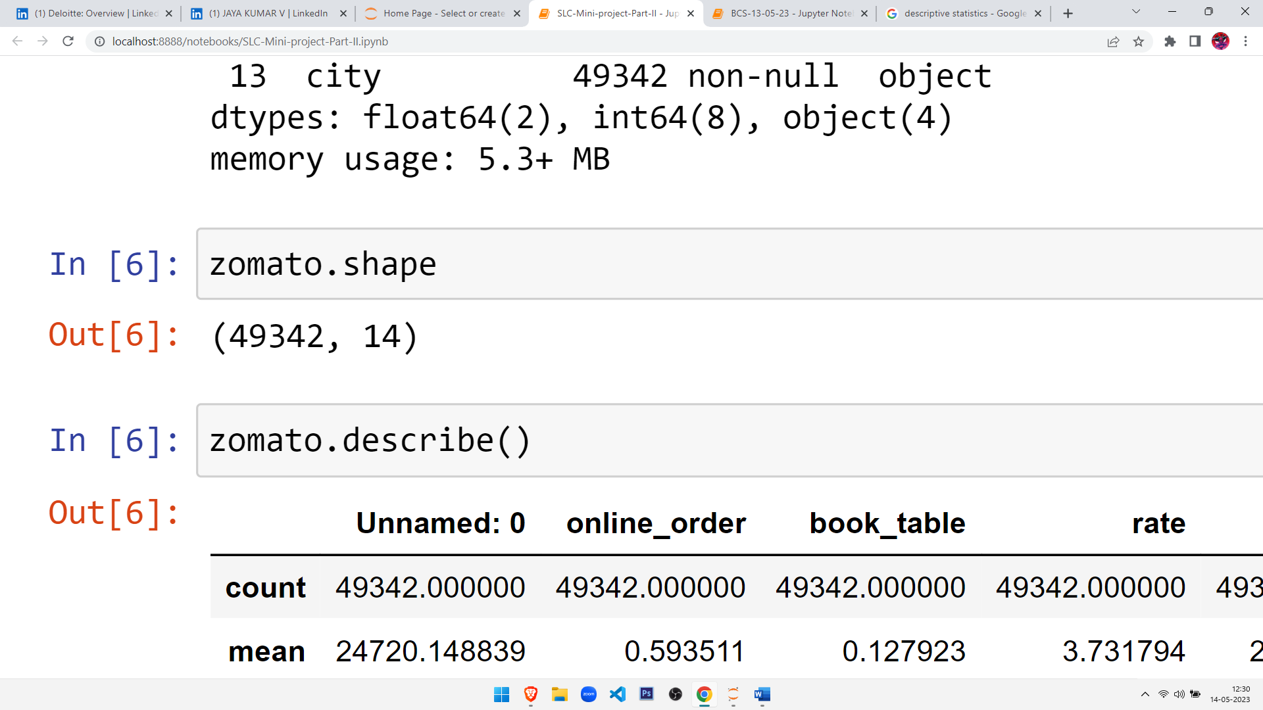
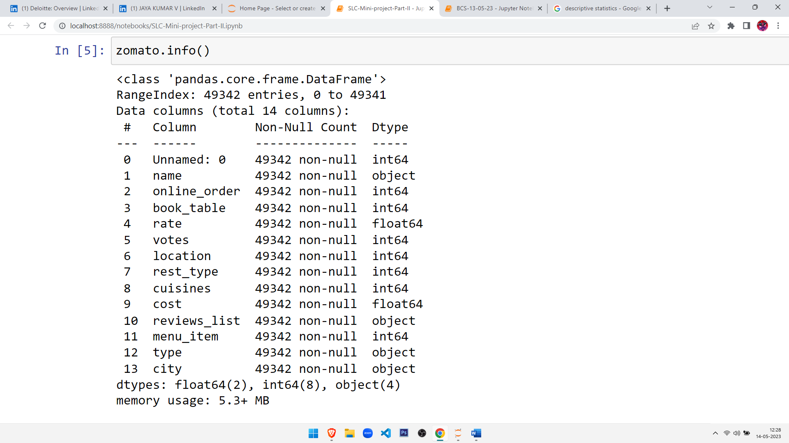
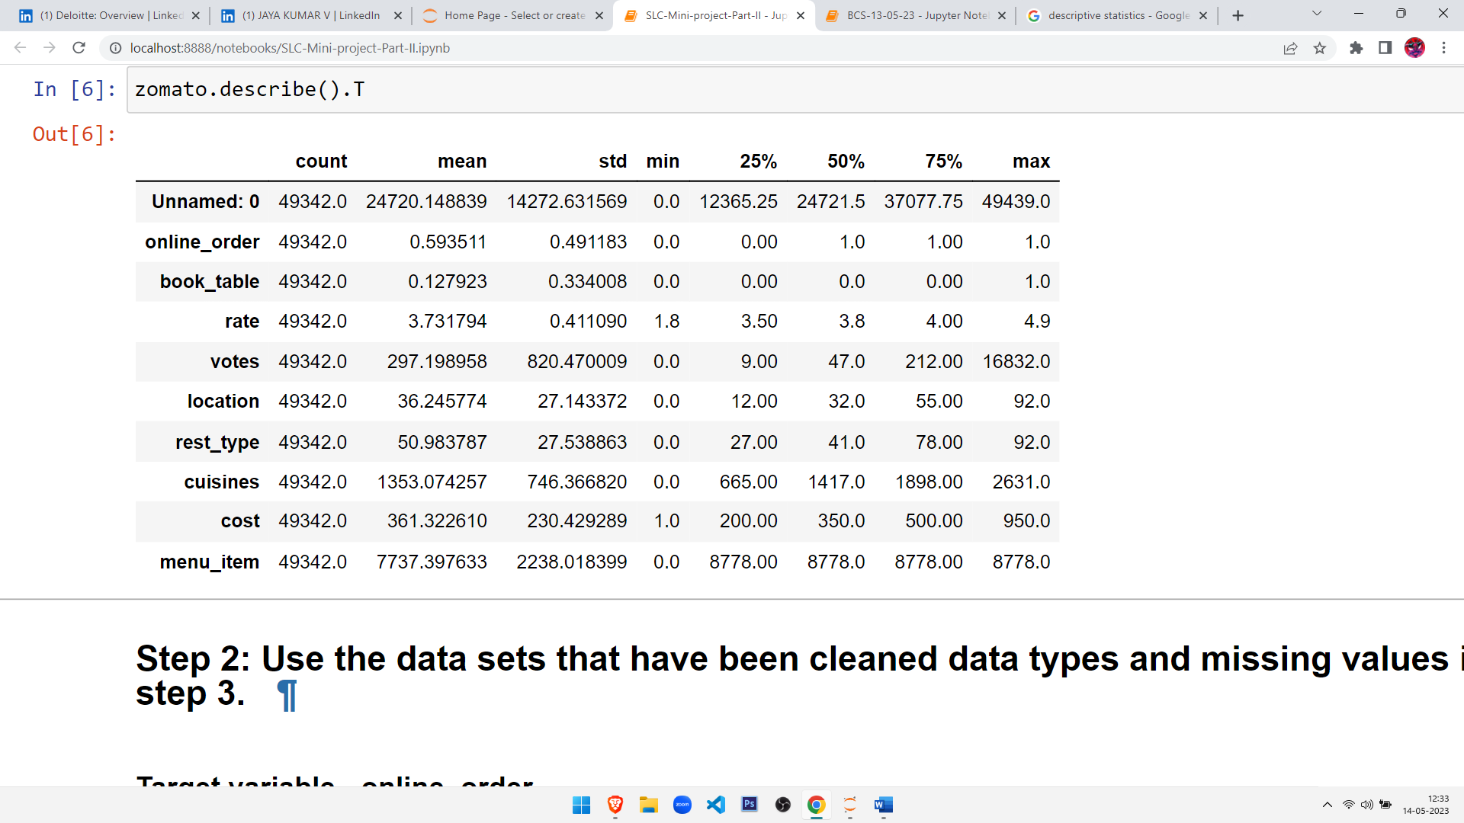
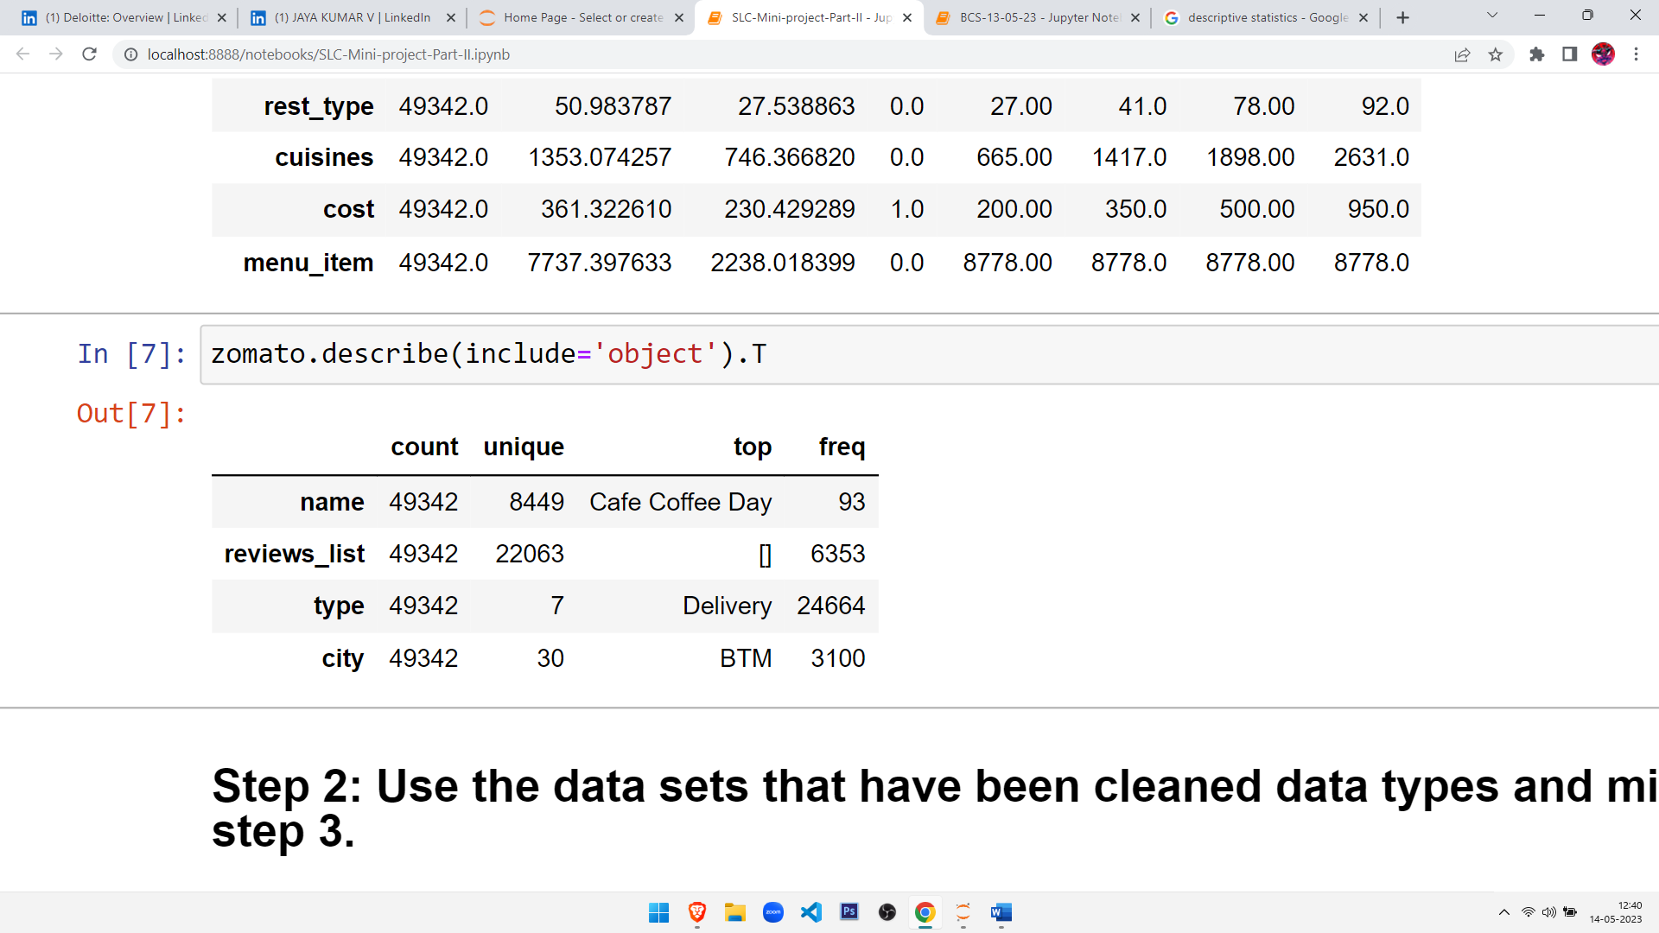
SOME STATISTICAL INFERENCES
We come to know that there are 49342 rows and 14 columns.
We come to know that there are 2- Discrete series, 8- Continuous and 4- object datatype from the above.
We come to know that there is no missing value in the given dataset.

Slide 6
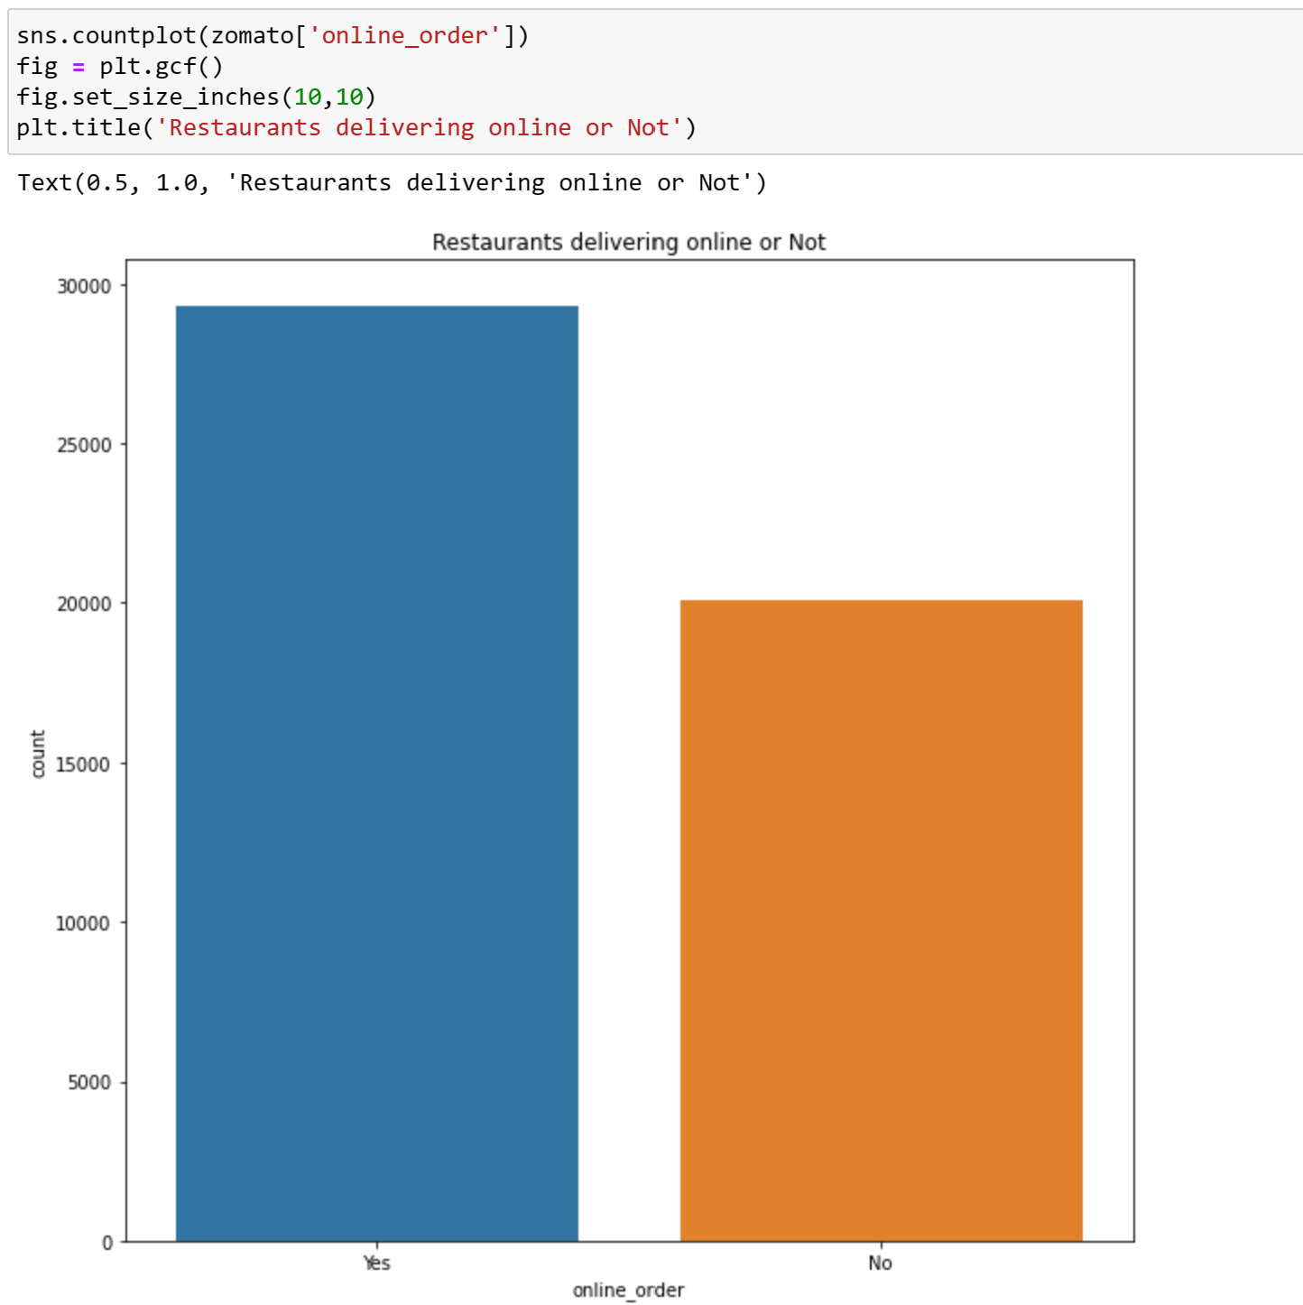
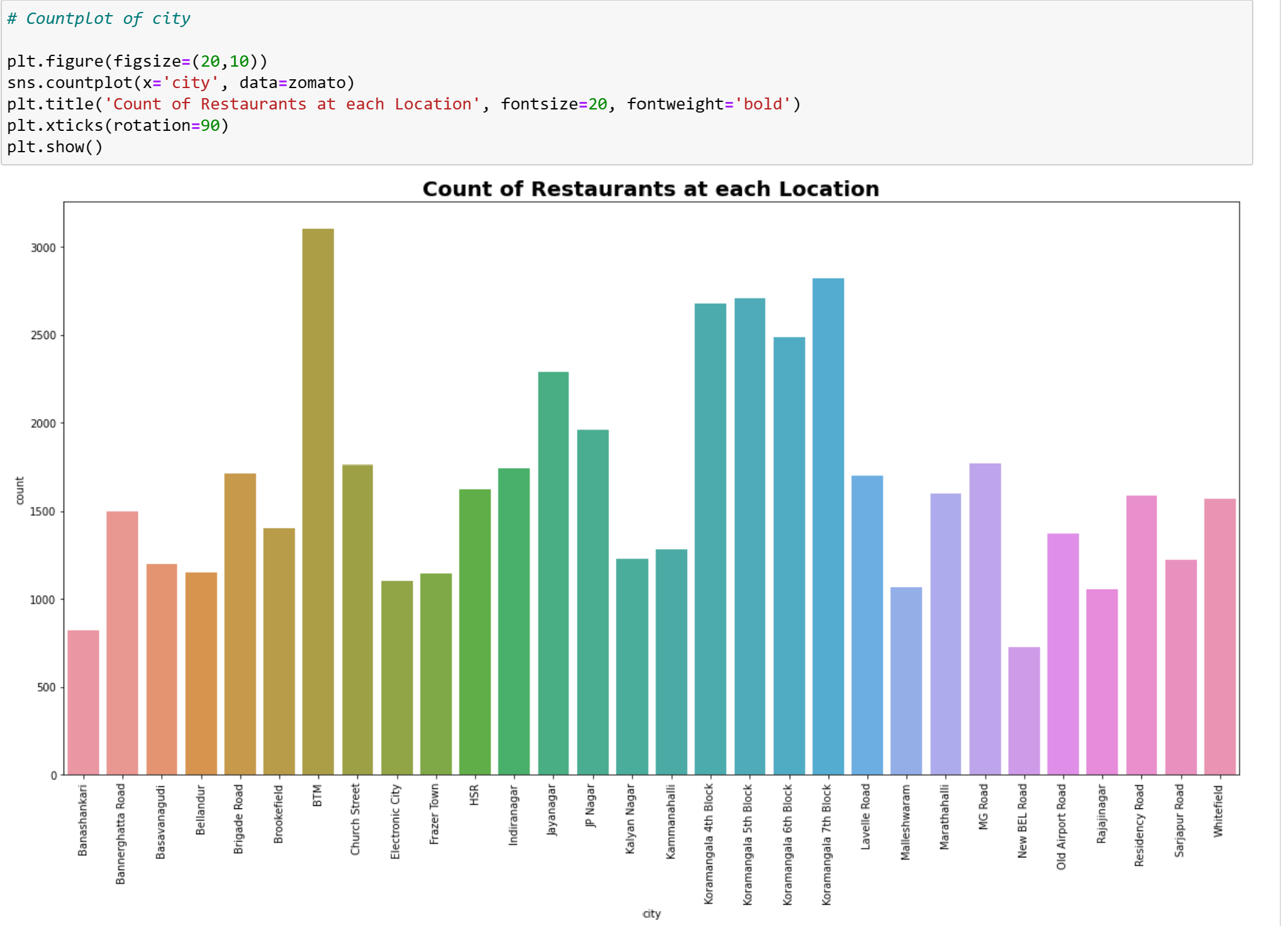
DATA VISUALIZATION
There are more than 3000 restaurants in BTM. Quick Google Search shows us that BTM is posh residential area so because of that there are quite a lot of restaurants and also it is famous for cafes. JP Nagar HSR, Koramangala 5th block, Whitefield, Indiranagar have more than 2000 restaurants and Jayanagar, Marathahalli, Bannerghatta Road have more than 1000 restaurants.

Slide 7
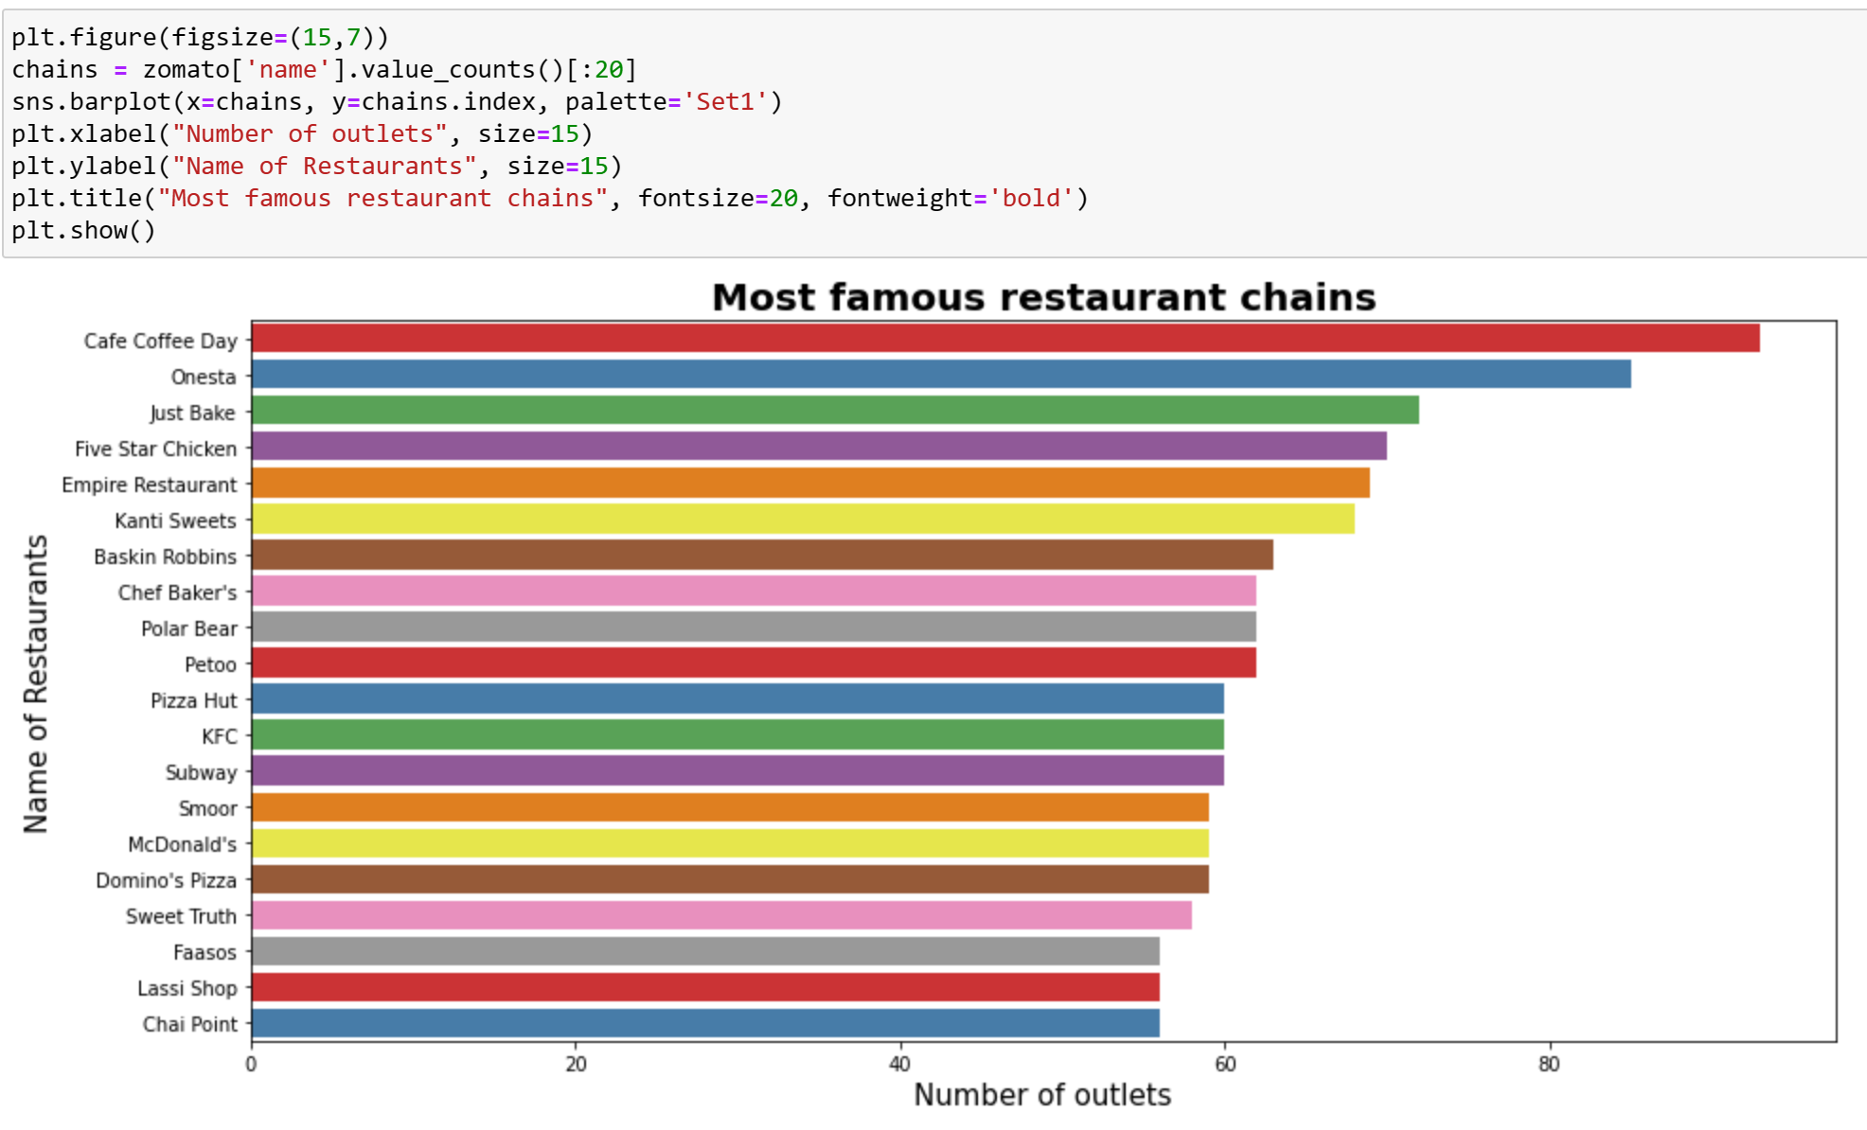
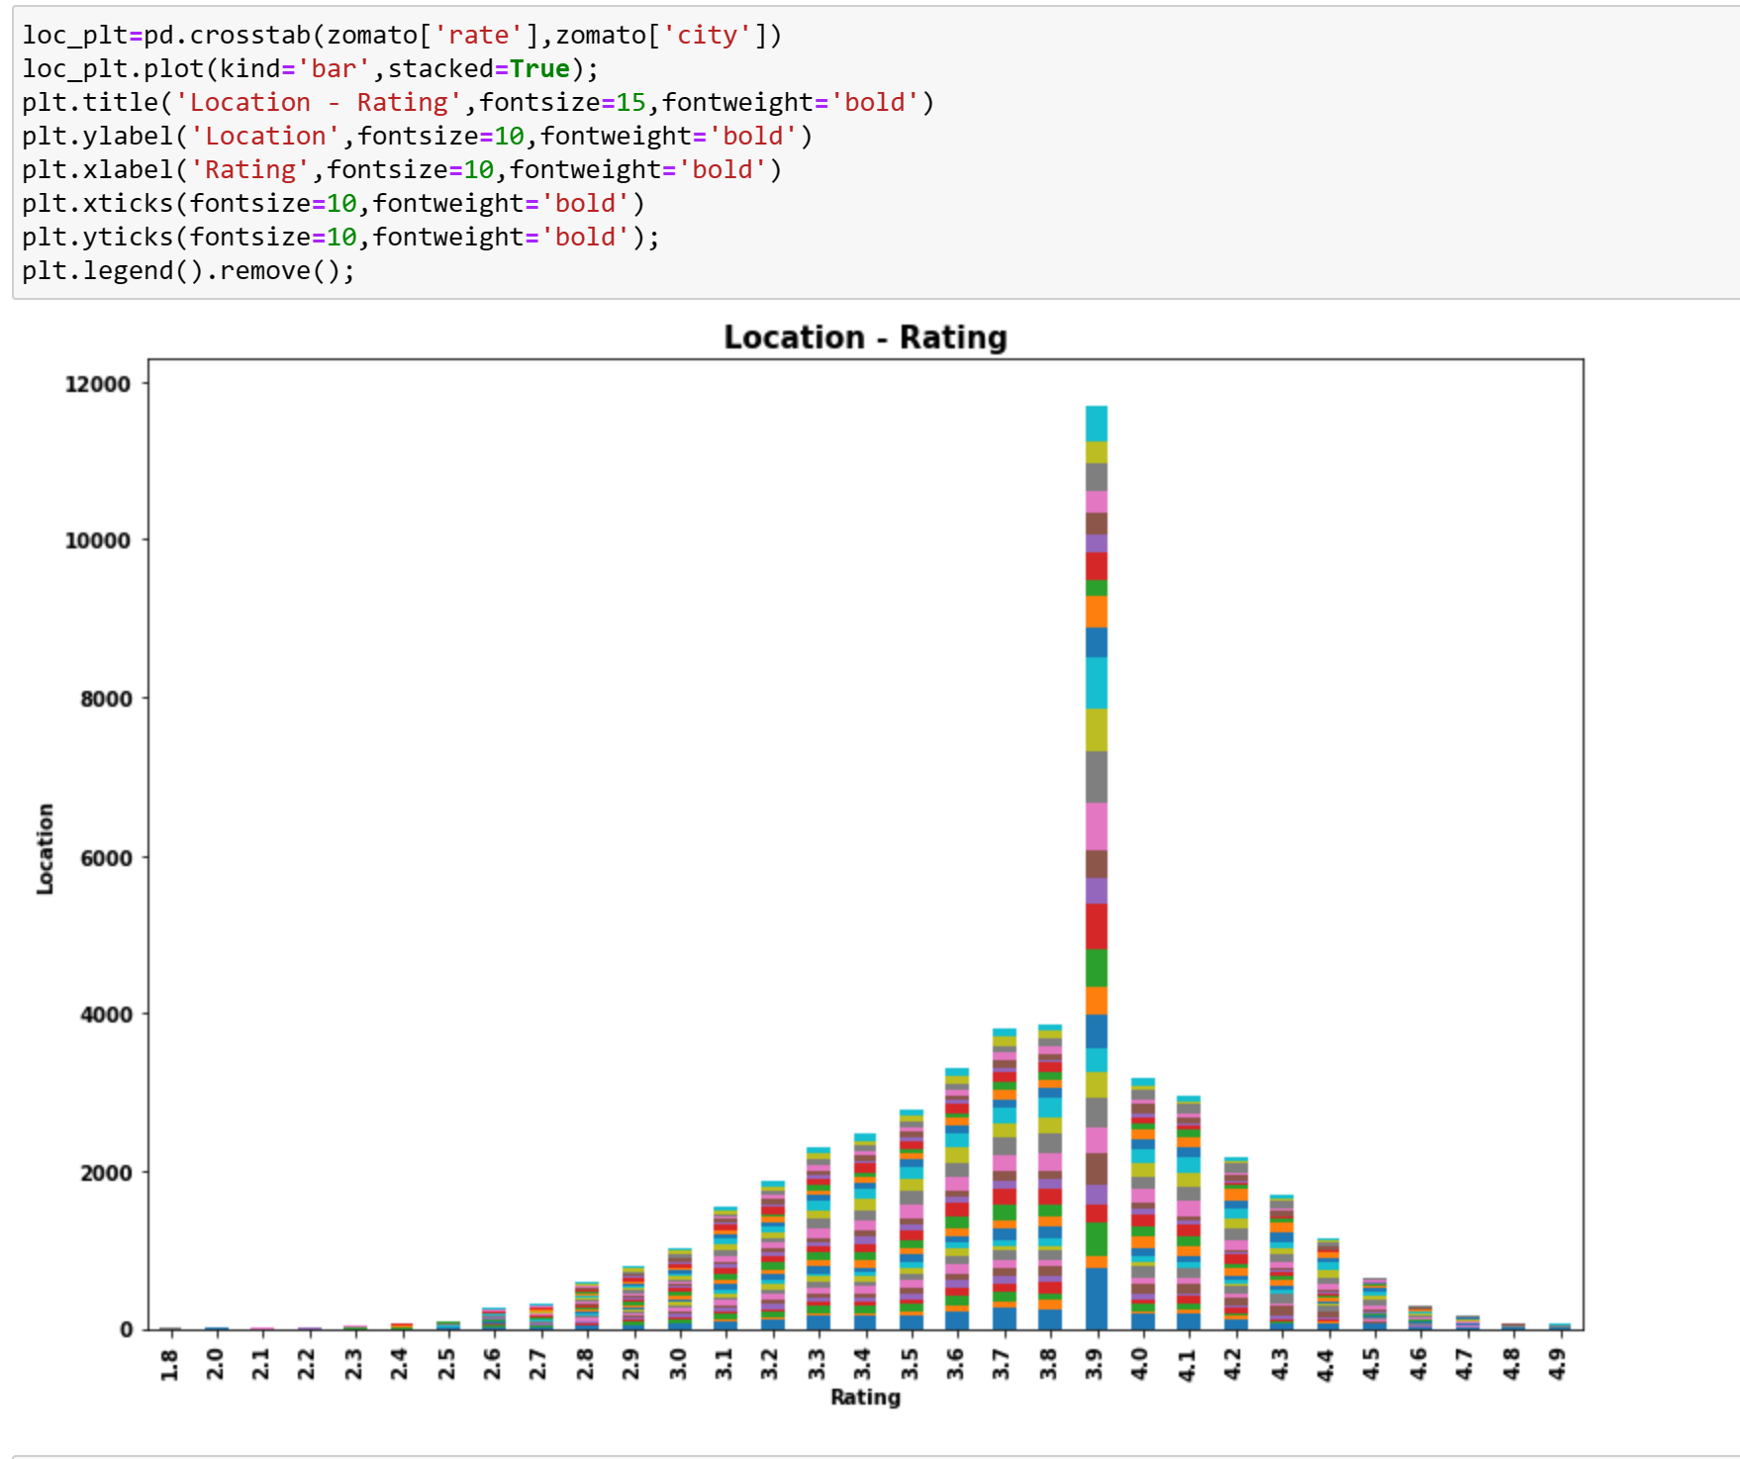
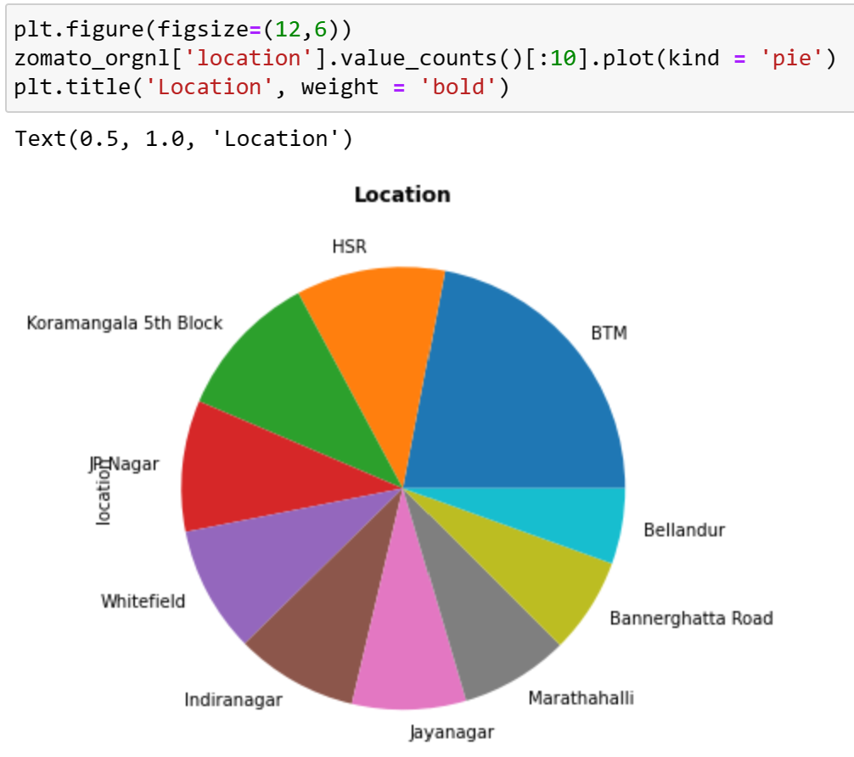
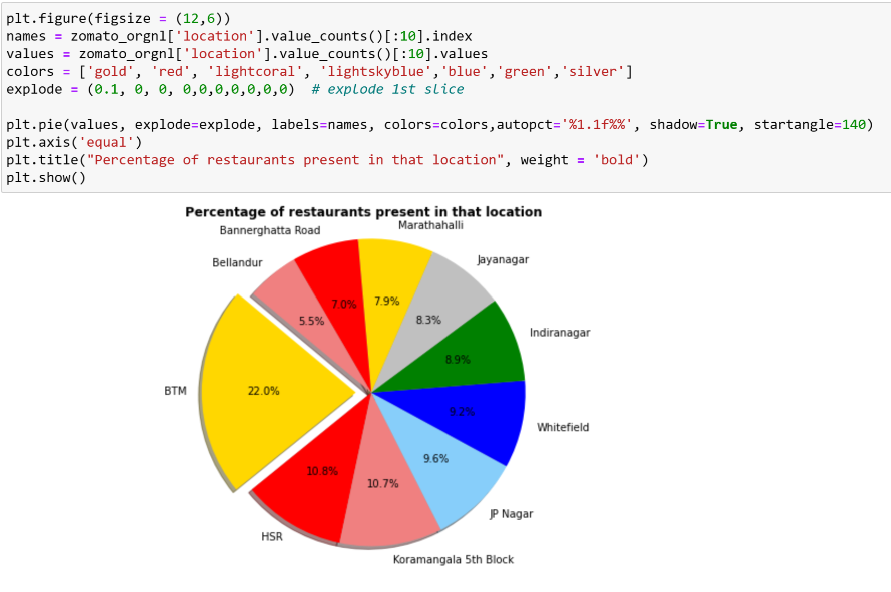
DATA VISUALIZATION
Given some Visualization plots to get more understanding of data

Slide 8
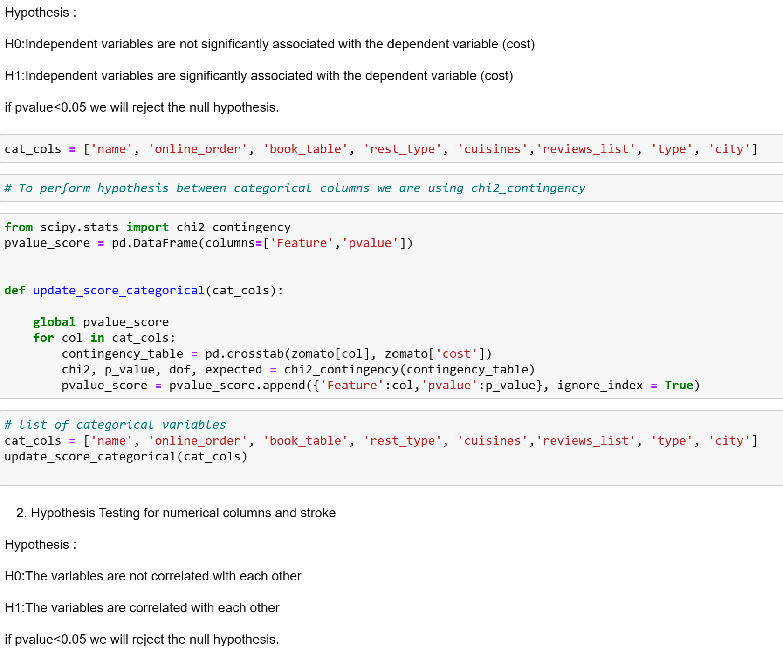
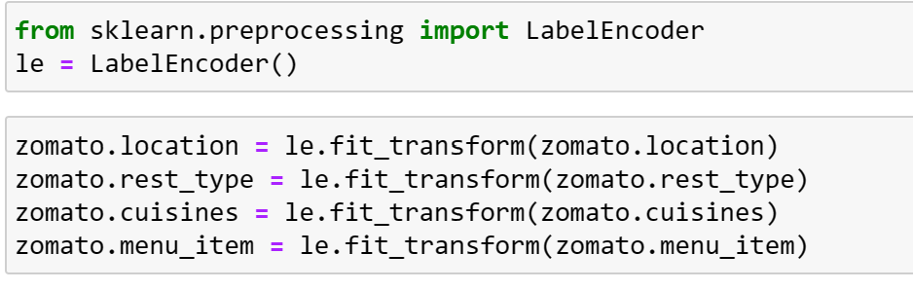
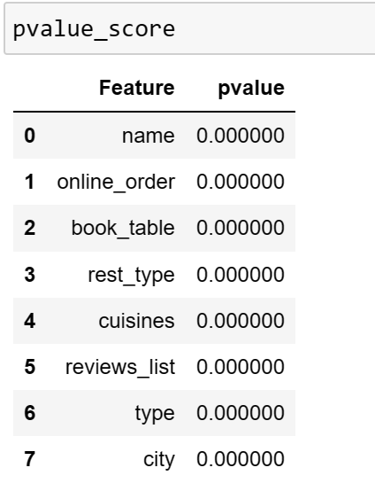
ENCODING AND HYPOTHESIS
Hypothesis Test proves that all the Variable are correlated with each other
We used LabelEncoder to transform the data.

Slide 9
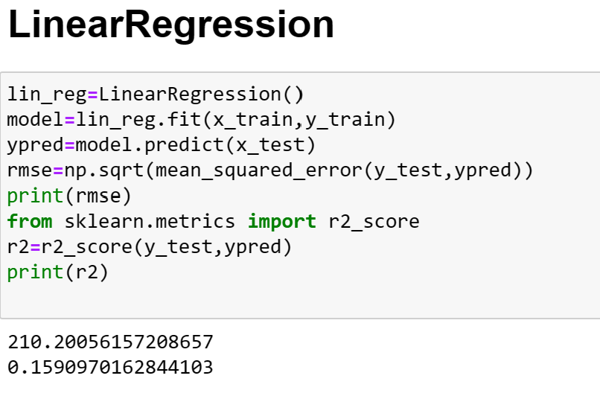
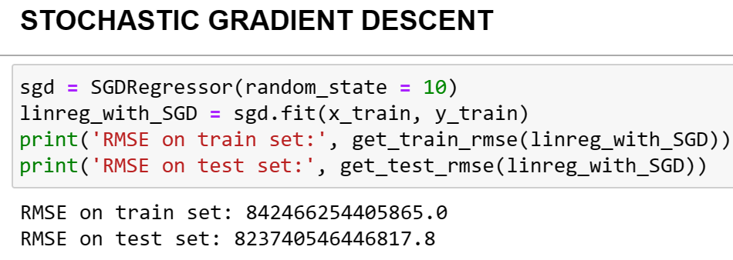
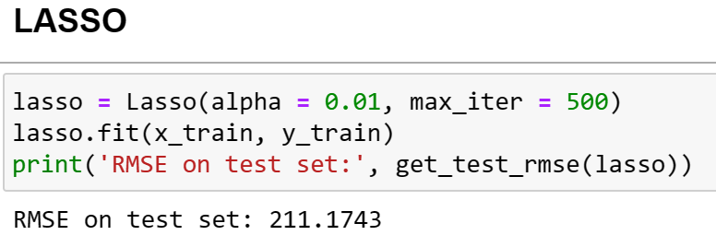
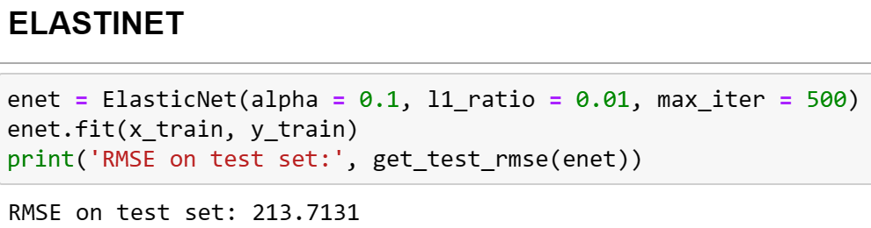
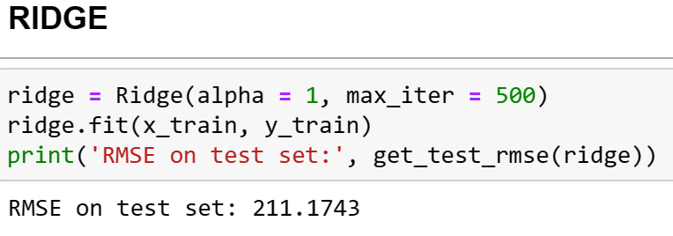
MACHINE LEARNING MODELS- REGRESSION

Slide 10
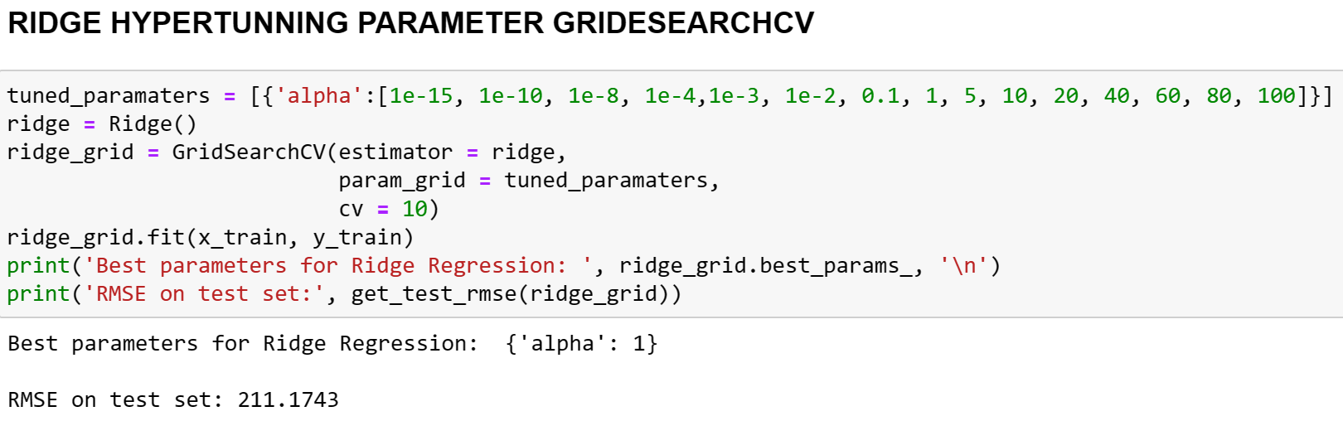
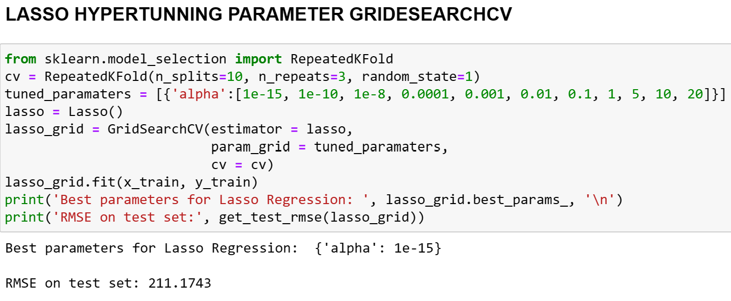
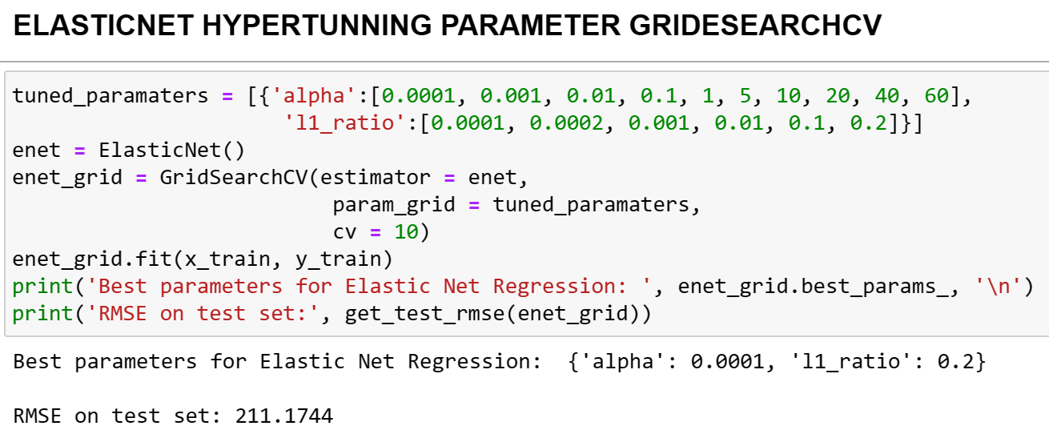
MACHINE LEARNING MODELS
Hyperparameter Tunning using GridSearchCV

Slide 11
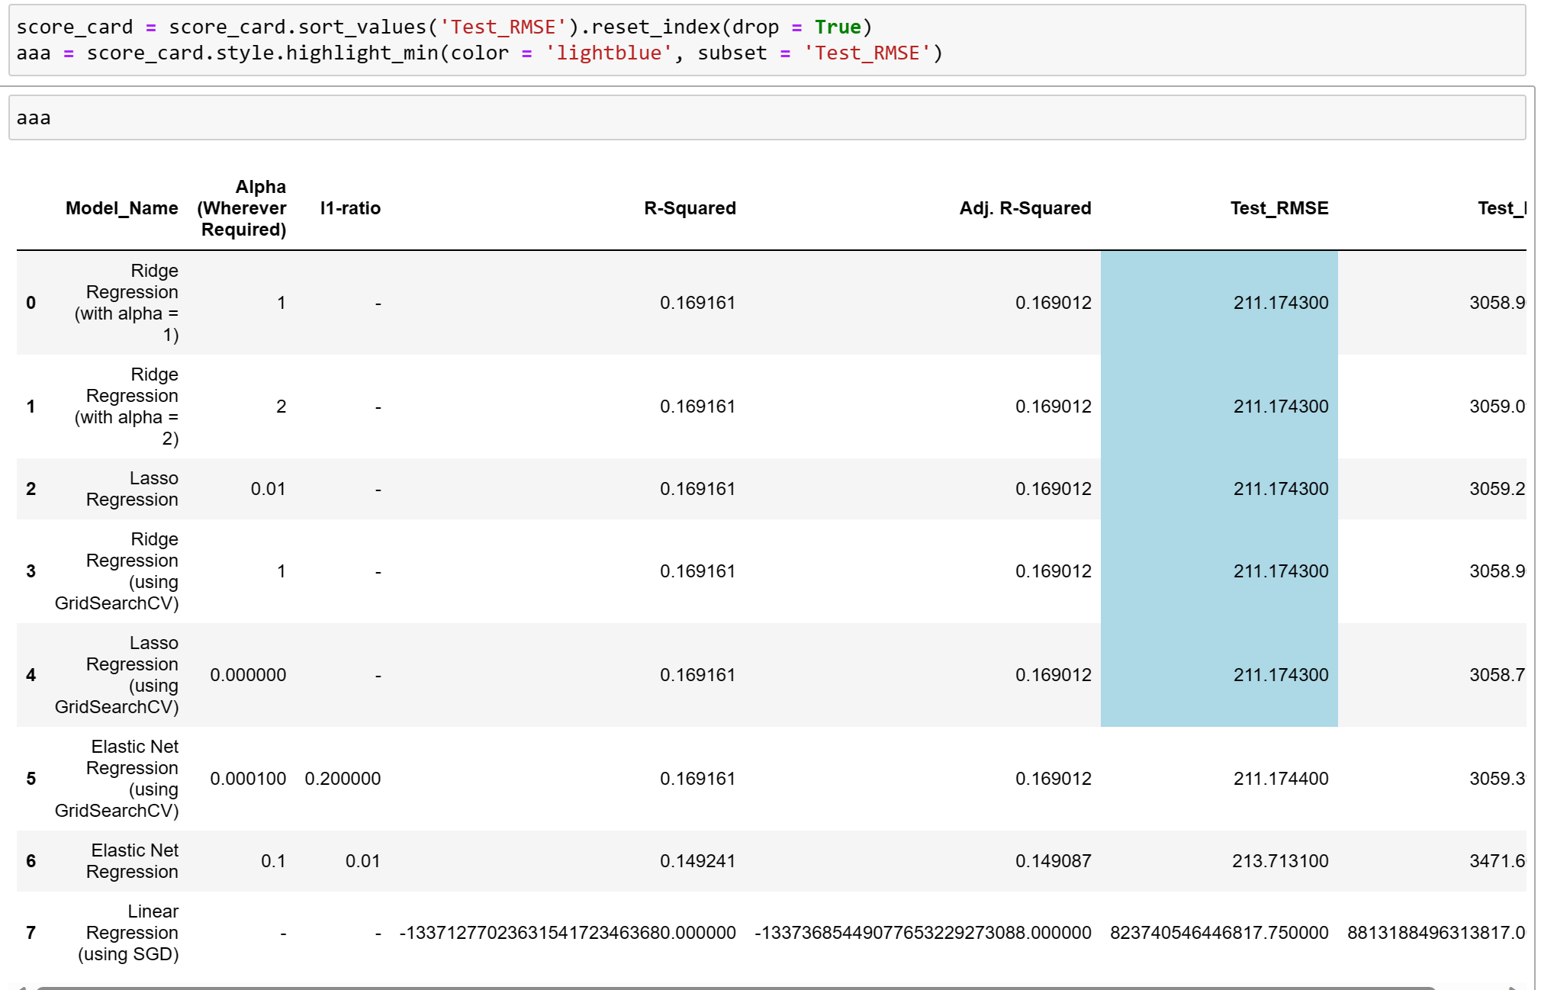
MODEL RESULT
Test RMSE is similar for 5 models. So we took Test MAPE and concluded that LASSO Regression using GridSearchCV performs well.

Slide 12

DATA ANALYSIS
PART- II
The project analyses the dataset and finds hidden patterns that could affect the target variable - online order. The analysis is divided into two parts: Univariate Analysis and Bivariate Analysis.
Univariate Analysis:
The univariate analysis analyses the variables individually. The project plotted the cost of online order vs. No online order to see the distribution of the target variable.
Bivariate Analysis:
The bivariate analysis analyses the relationship between two variables. The project visualized the relationship between the target variable and important features such as location, book table, type, city, and cost
Multivariate Analysis:
A pair plot is plotted to find the corelation between various variables in the dataset, we can’t derive a conclusion or any correlations.

Slide 13
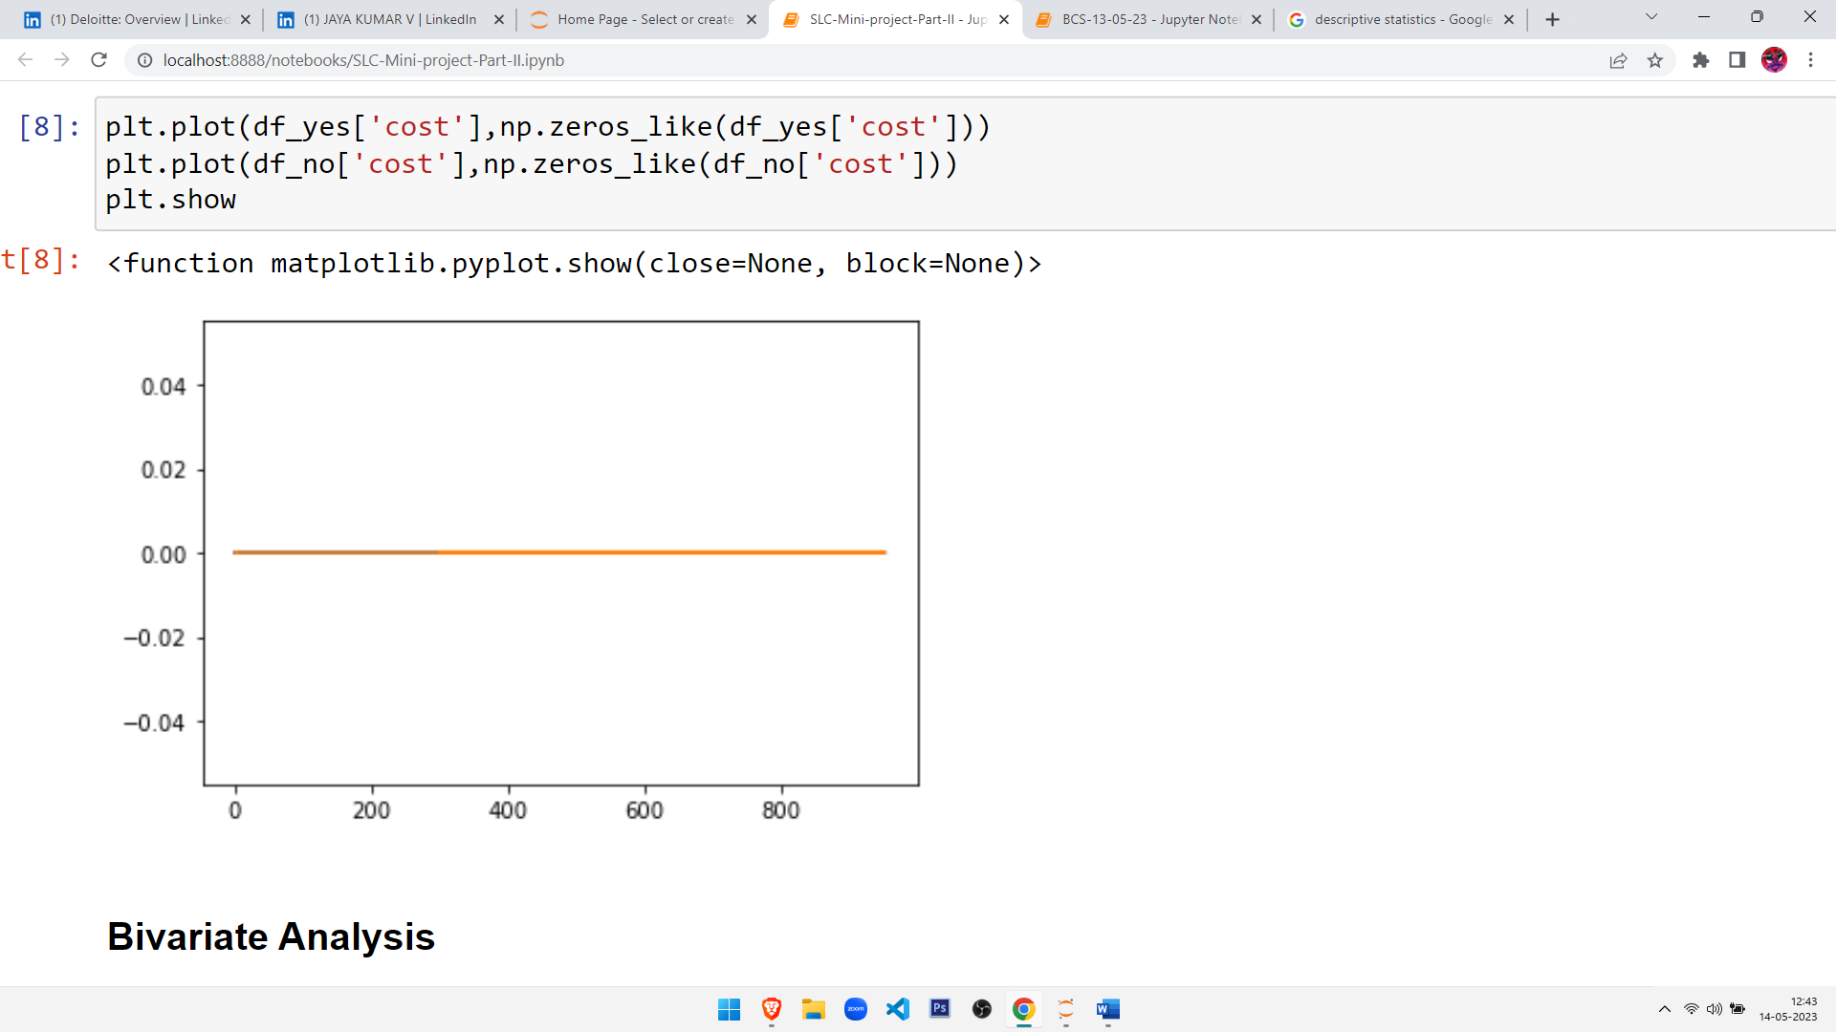
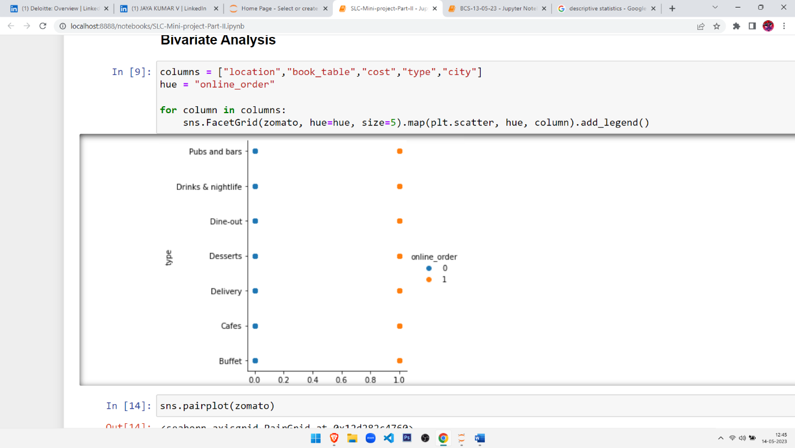
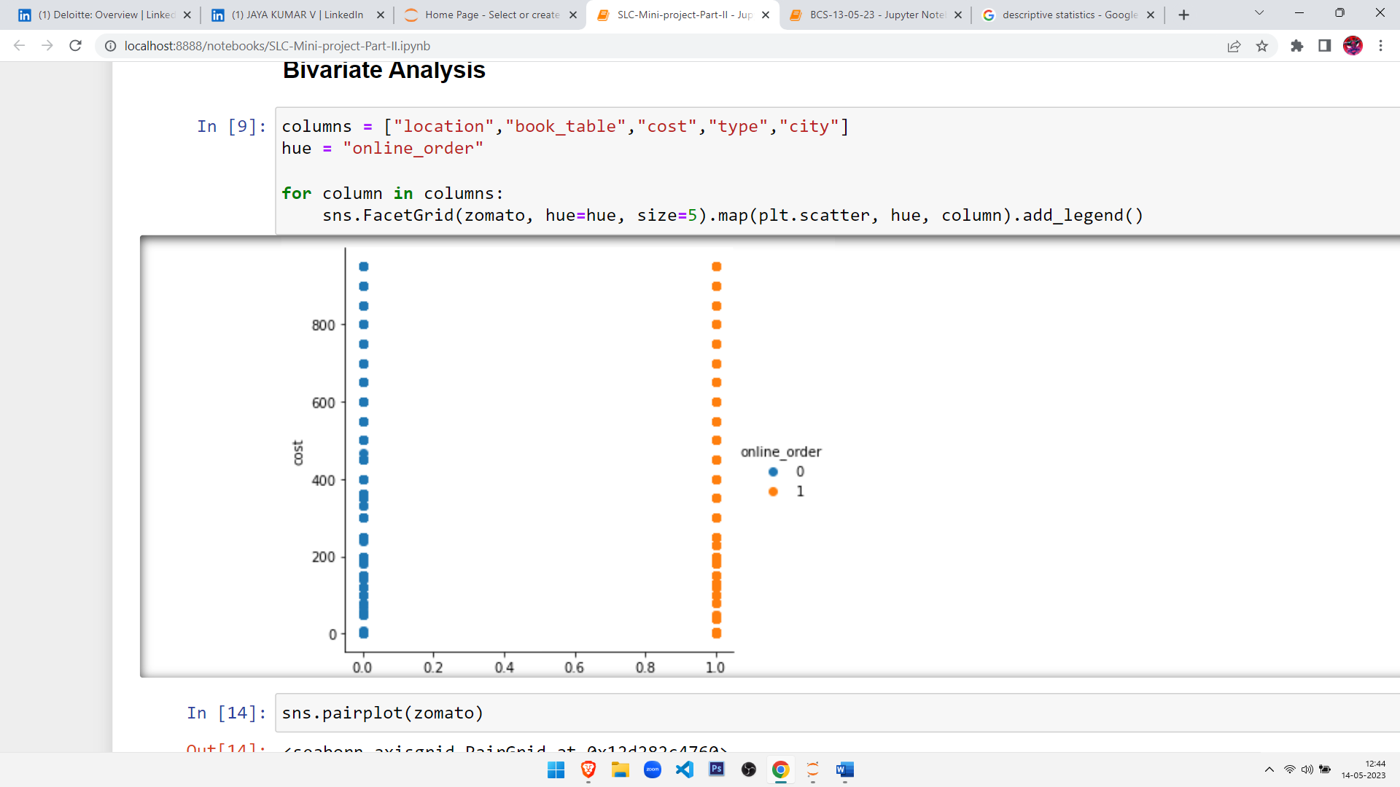
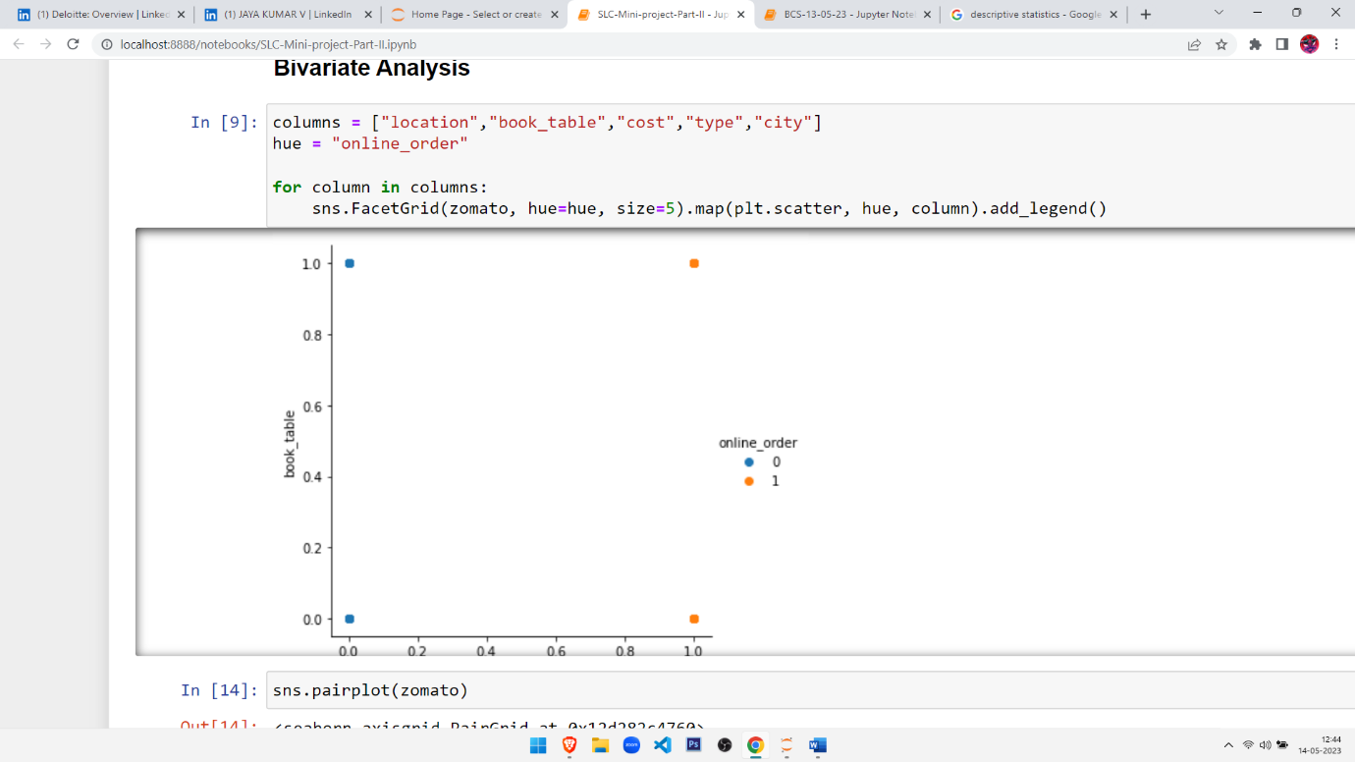
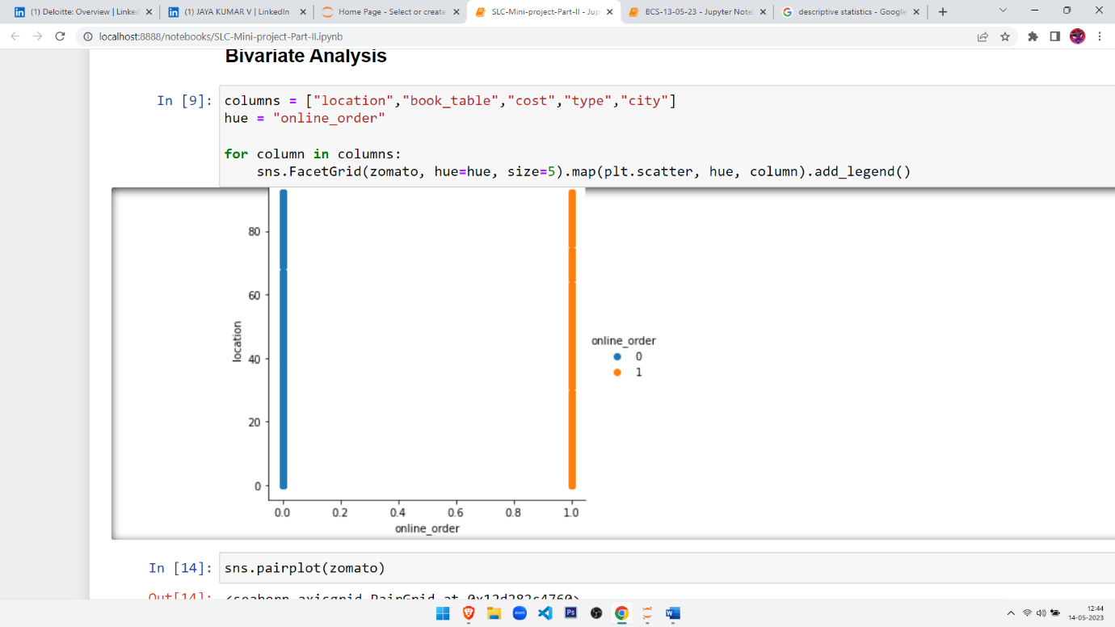
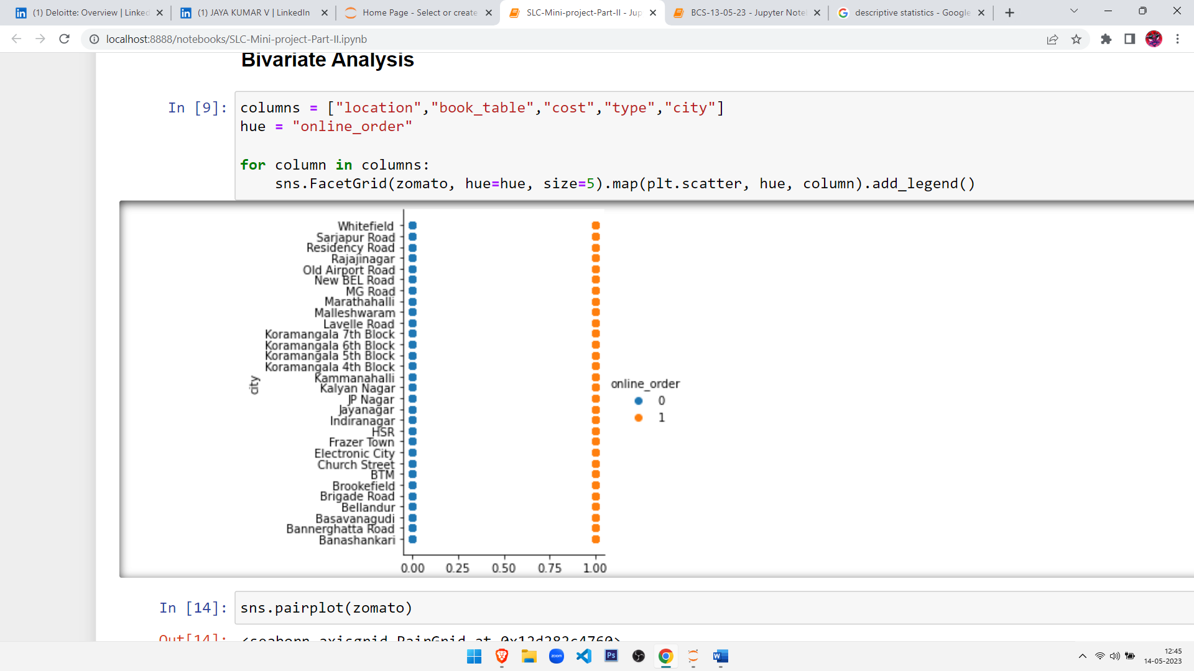
UNIVARIATE ANALYSIS:
Bivariate Analysis:
COST
type
Book_table
Location

Slide 14

FEATURE SELECTION
We use various techniques to select the most relevant features for the target variable - online order. The techniques include:
Identify
Identify the categorical and numerical features
Check
Check the distribution of the target variable
Plot
Plot the correlation matrix
Visualize
Visualize the relationship between the target variable and important features
T-test
Perform t-test to compare "online_order" rate between restaurants with and without table booking
Lasso regression
Perform Lasso regression to select the most relevant features
Random Forest
Perform Random Forest classification to determine feature importance

Slide 15
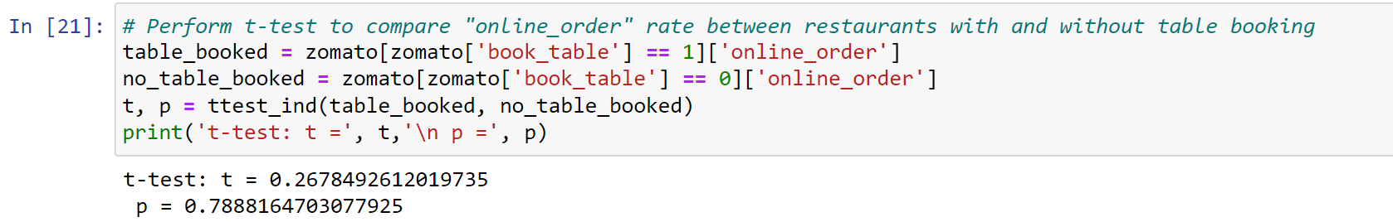
Perform t-test to compare "online_order" rate between restaurants with and without table booking
In this step, we perform a t-test to compare the rate of 'online_order' between restaurants with and without table booking. This helps to identify if there is a significant difference in the rate of online ordering between the two.

Slide 16
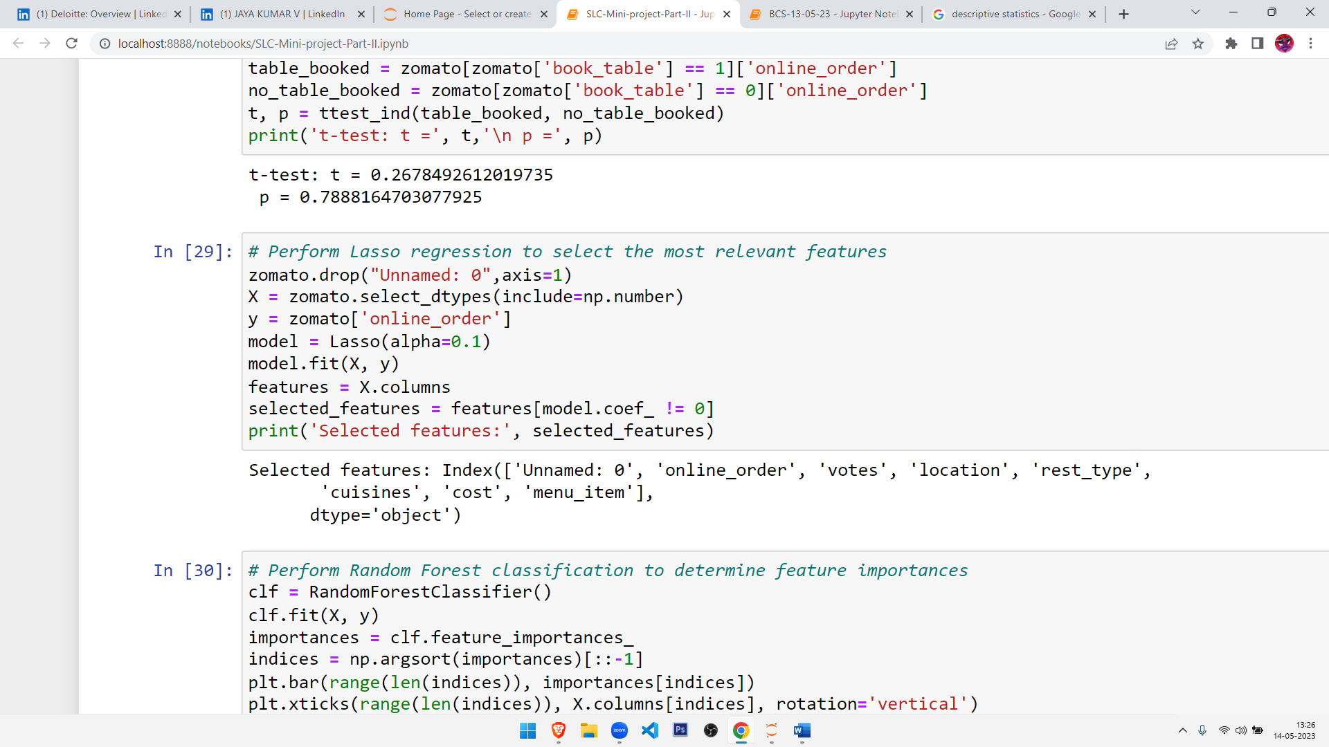
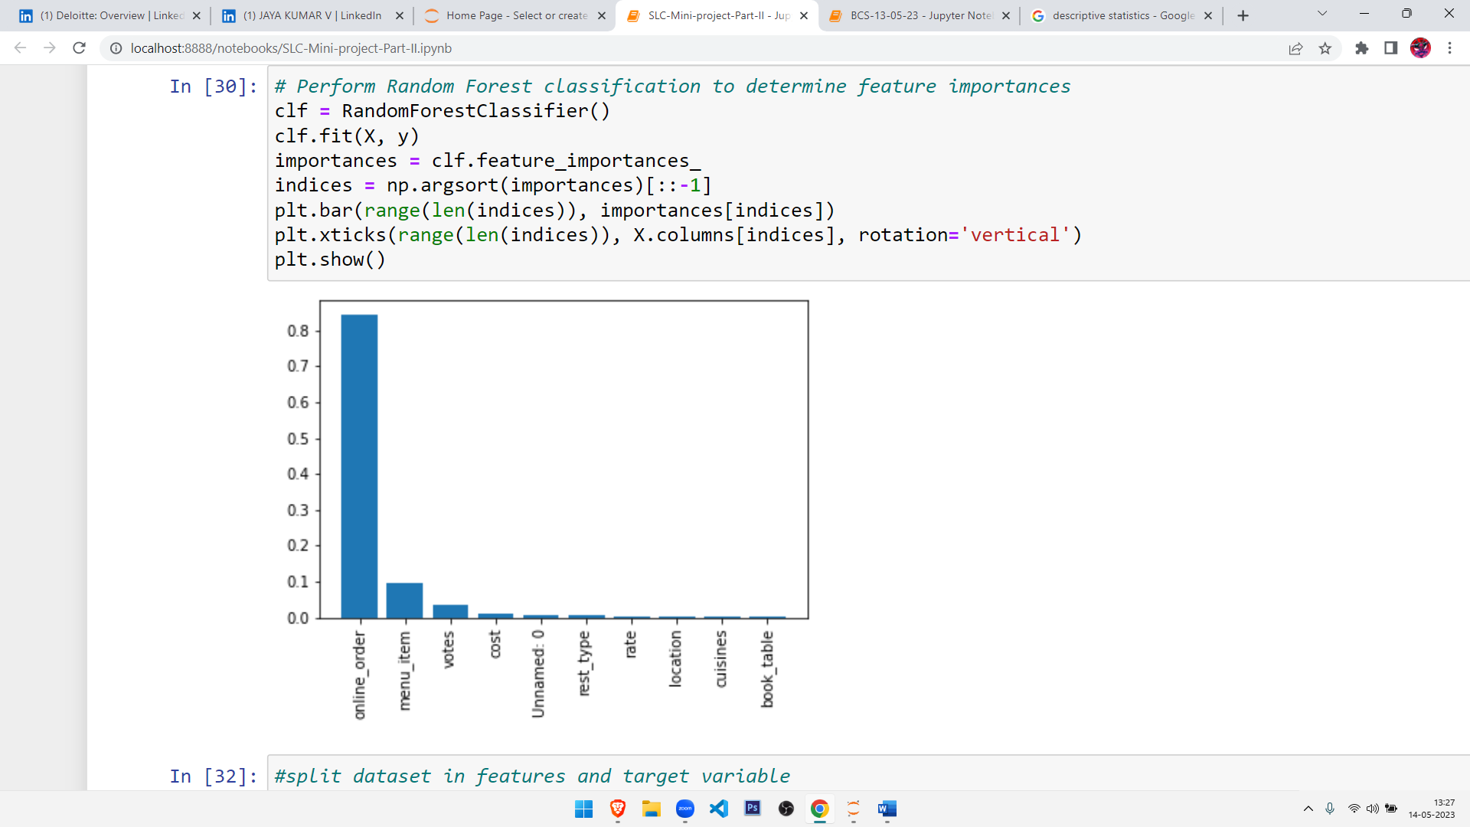
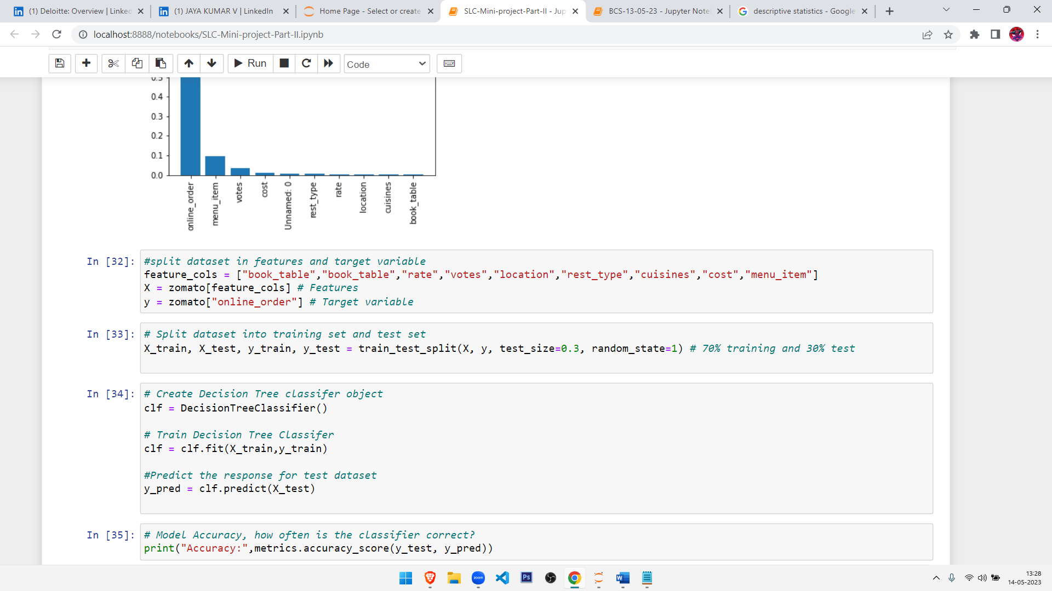
Lasso regression
Random Forest classification
Splitting the data into train and test sets.

Slide 17
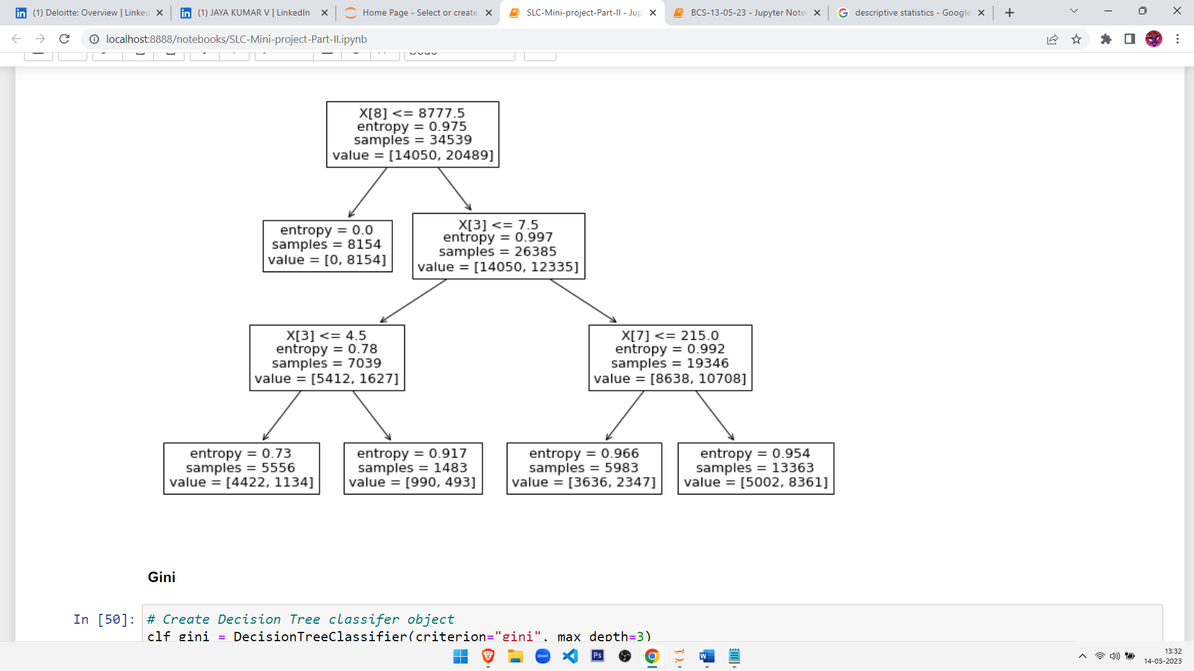
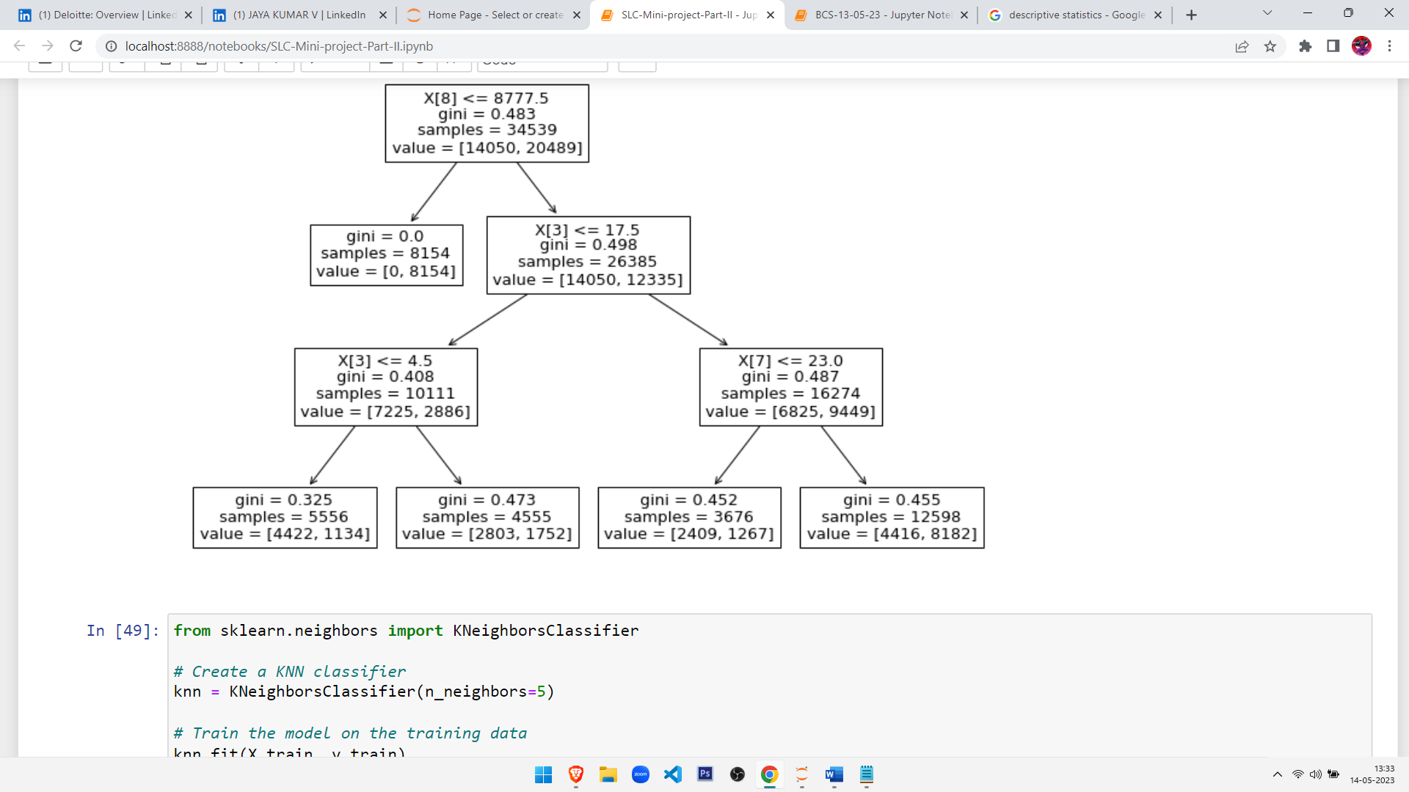
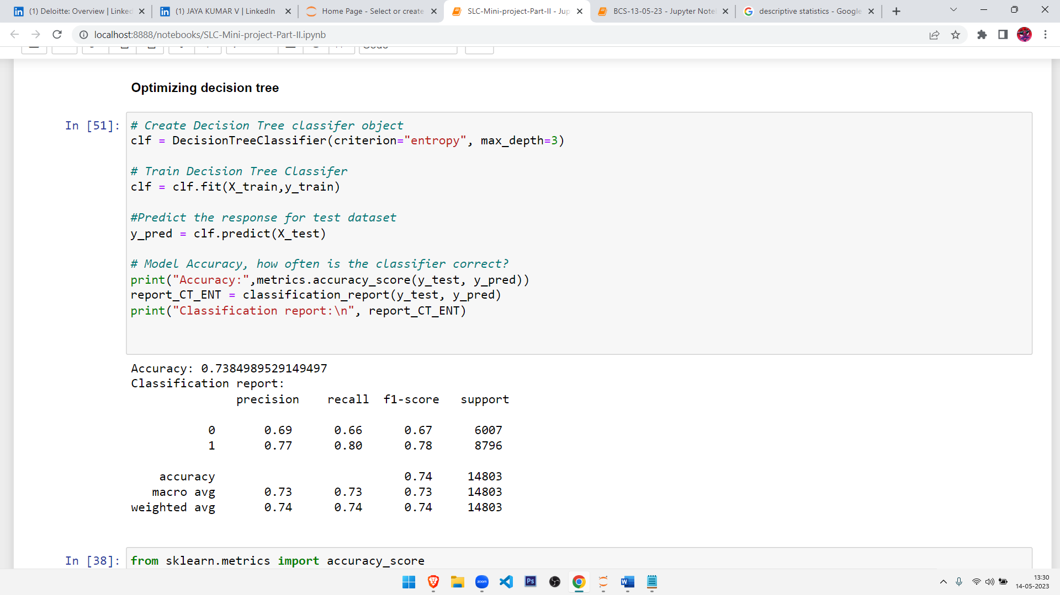
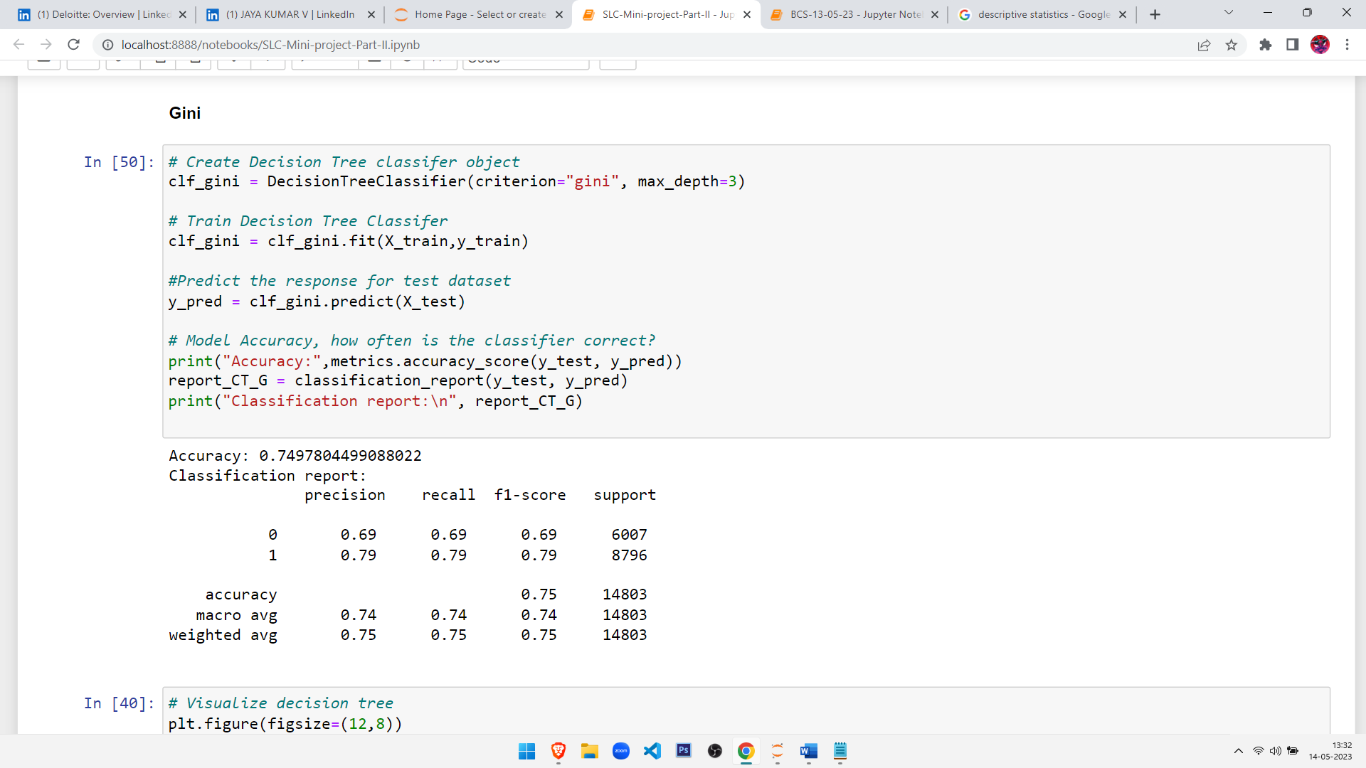
BUILDING THE BASE MODEL AND IDENTIFYING THE METRIC BASED ON THE PROBLEM
Decision Tree (Entropy):
Decision Tree (GINI):

Slide 18
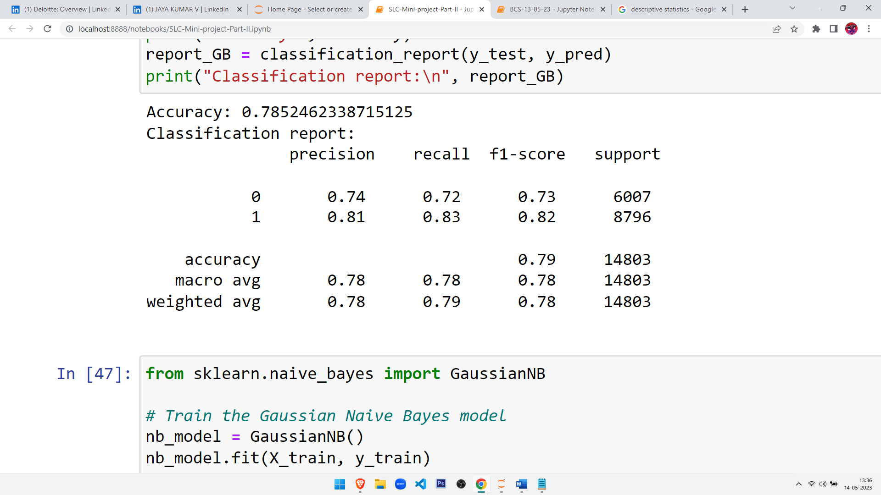
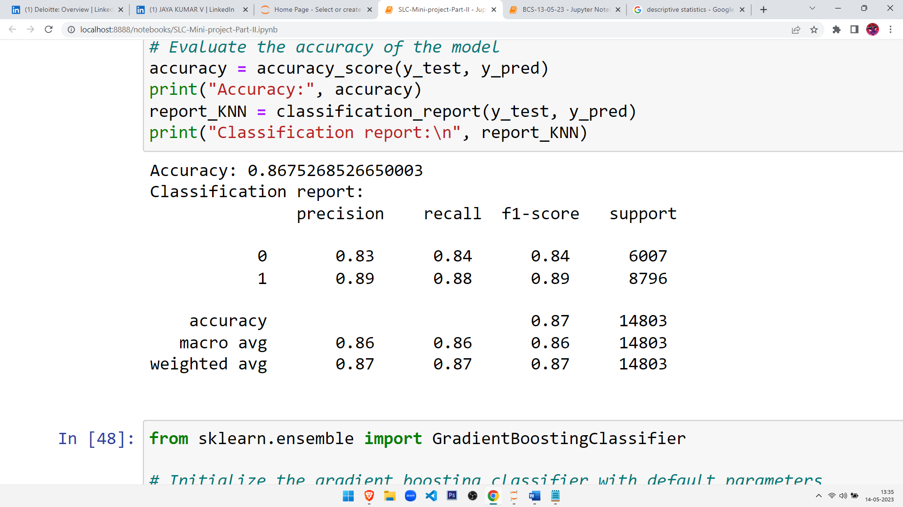
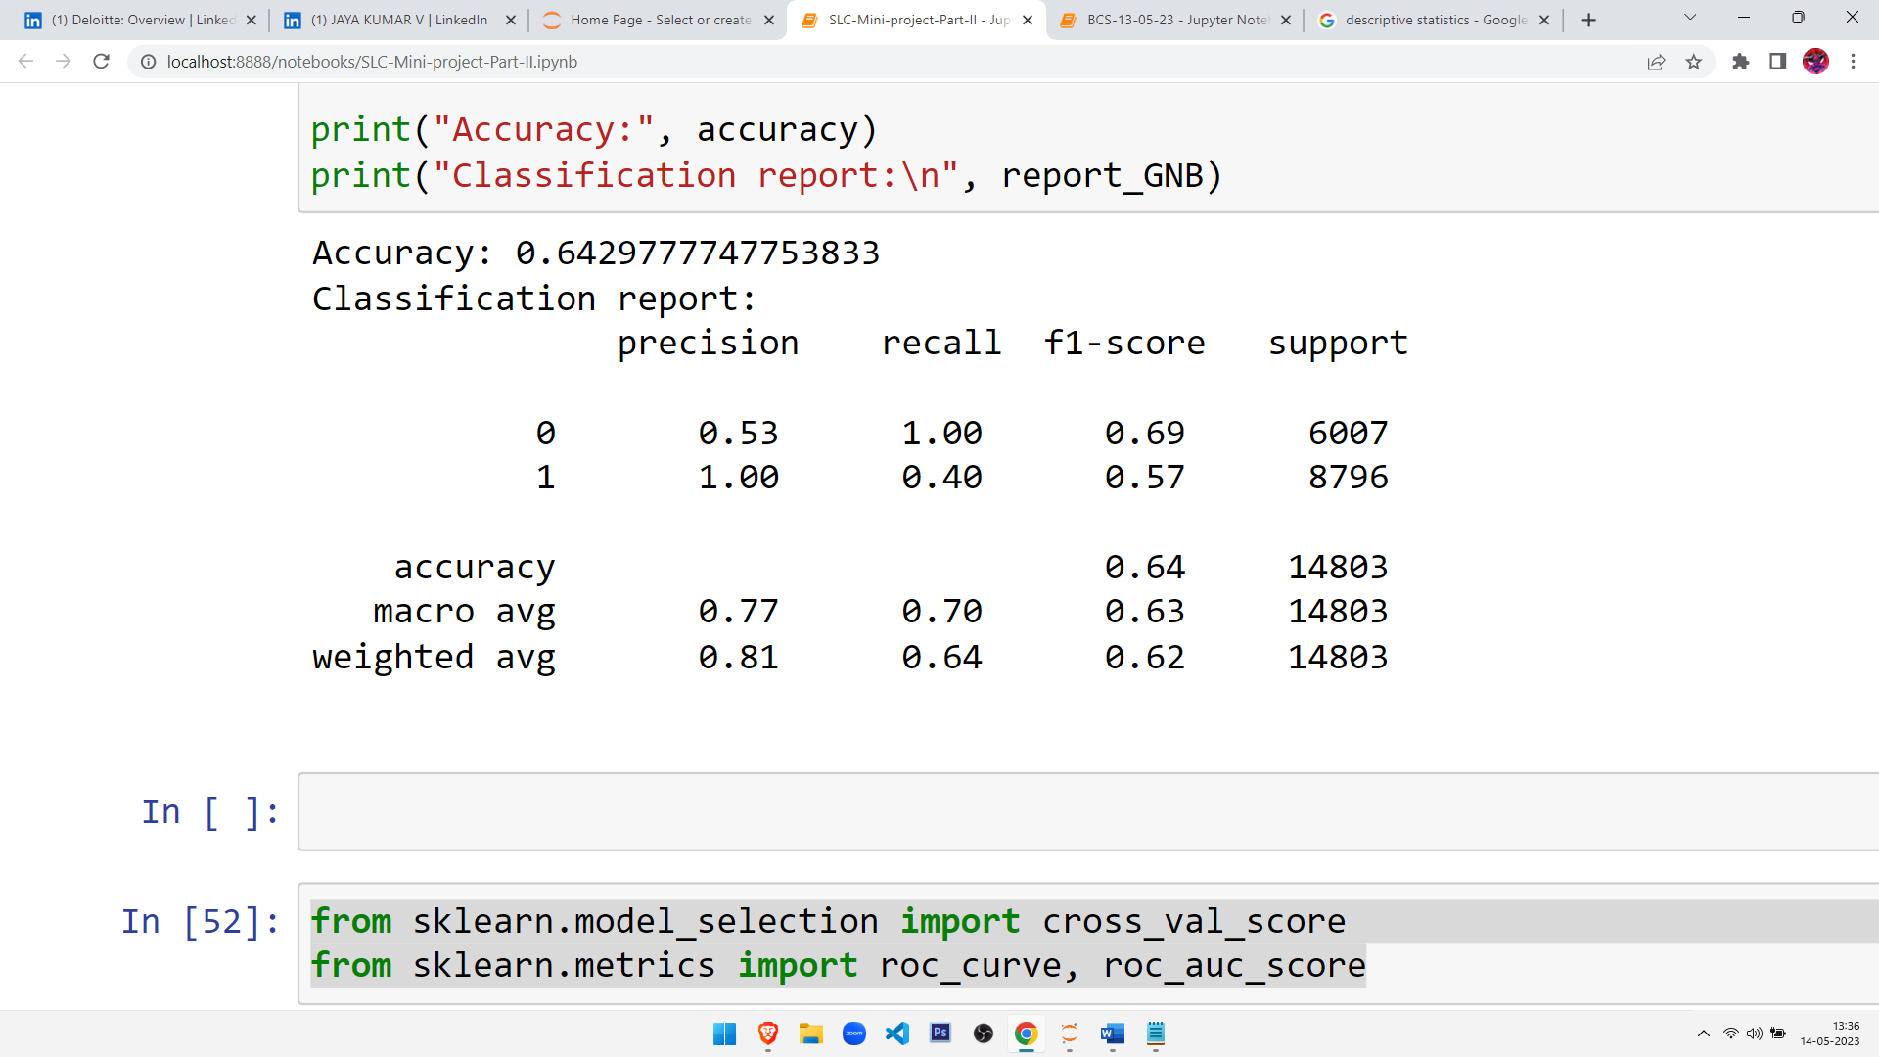
K- NEAREST NEIGHBORS ALGORITHM
GRADIENT BOOSTING CLASSIFIER
GAUSSIAN NAÏVE BAYES CLASSIFIER

Slide 19
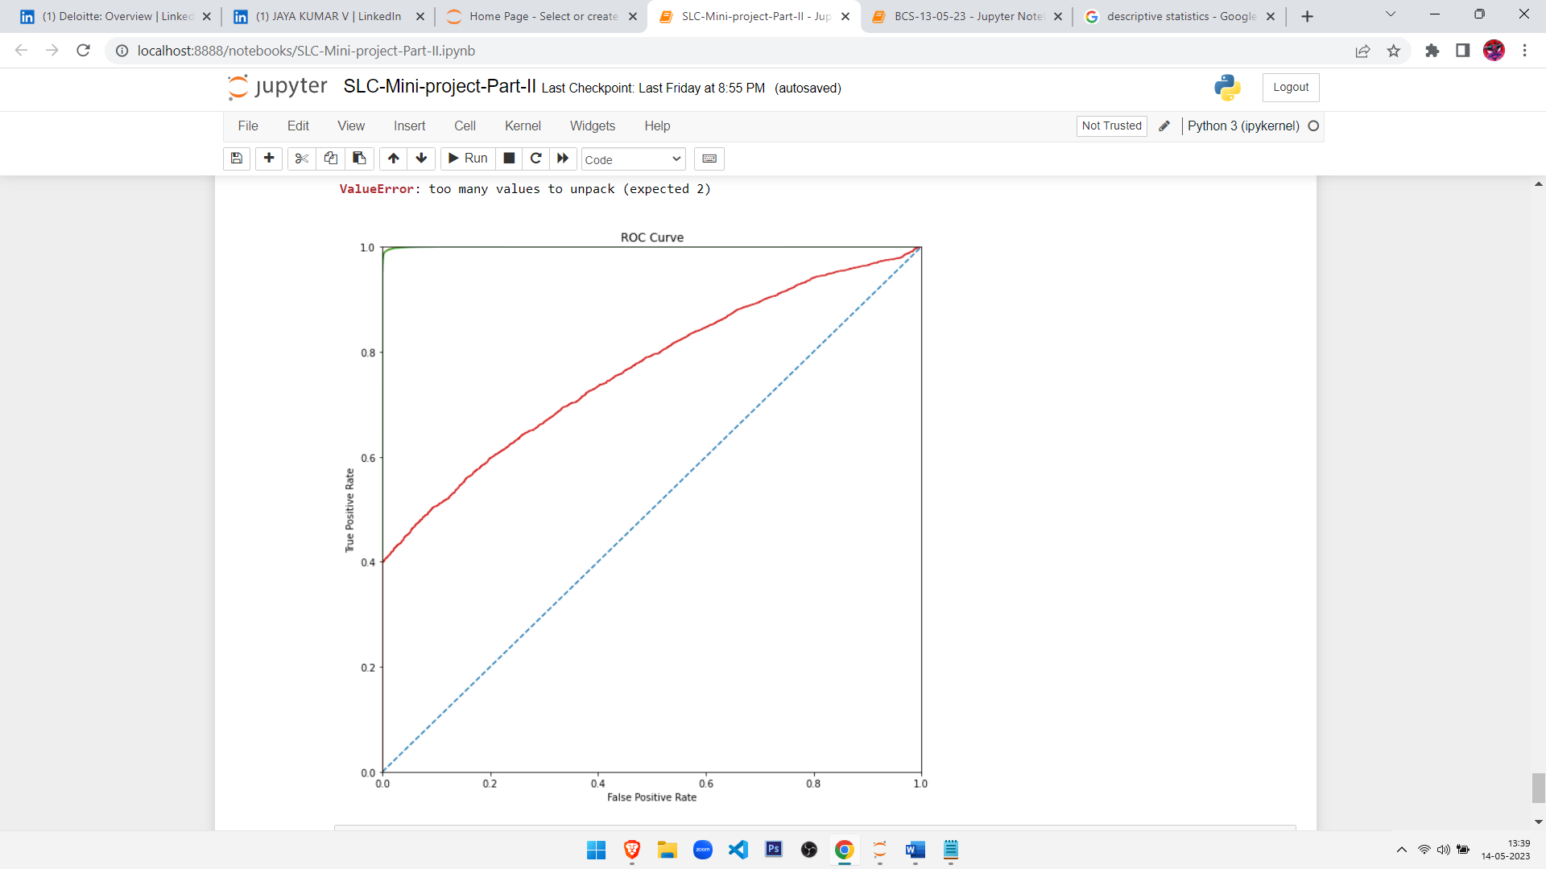
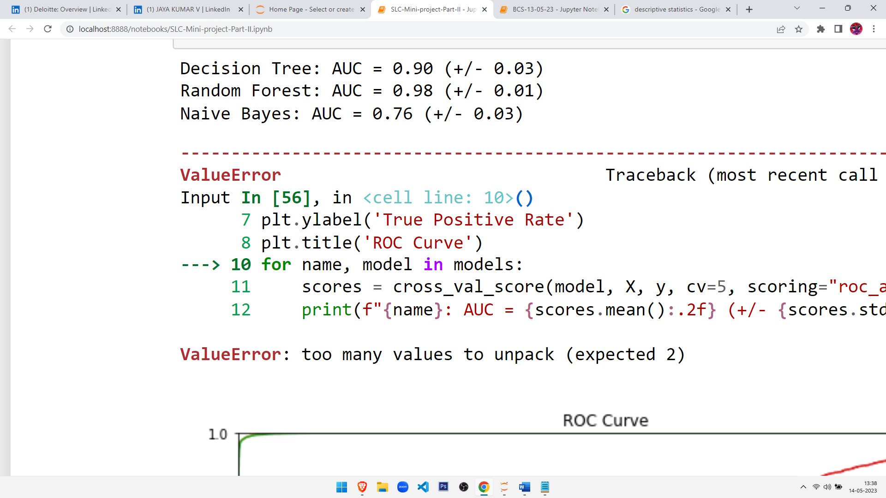
CHOOSING THE FINAL MODEL

Slide 20

TAKEAWAY AND CONCLUSION
We compare the performance of three different classification models: Decision Tree, Random Forest, and Naive Bayes, using 5-fold cross-validation and ROC curve.
The output shows the average area under the receiver operating characteristic (ROC) curve (AUC) and its standard deviation for each model. The ROC curve is a graph that shows the trade-off between true positive rate (sensitivity) and false positive rate (1-specificity) for different classification thresholds. An AUC of 1 indicates a perfect classification model, while an AUC of 0.5 indicates a random guess.
According to the results, the Random Forest model performs the best with an AUC of 0.98 (+/- 0.01), followed by the Decision Tree model with an AUC of 0.90 (+/- 0.03). The Naive Bayes model has the lowest AUC of 0.76 (+/- 0.03), indicating that it performs the worst among the three models.
Overall, the results suggest that the Random Forest model is the most suitable for predicting the target variable, online order, based on the given features.

Slide 21
Mini Project Team 7
Deepti Singh
Chikkili Hema Kumar
Swetha R Ve
Ranga Bashyam G

Slide 22


